Slide 1
Recent Trends in Fingerprint Evidence
2012 Texas Forensic Science Seminar
Melissa R. Gische
Physical Scientist/Forensic Examiner
Latent Print Operations Unit
FBI Laboratory
(703) 632-7143
melissa.gische@ic.fbi.gov

Slide 2
Agenda
Fingerprints 101
Comparison Process
Madrid Error
NAS Report on Forensic Science
NIST Report on Human Factors in Latent Print Analysis
Hot Topics

Slide 3
Fingerprints 101

Slide 4
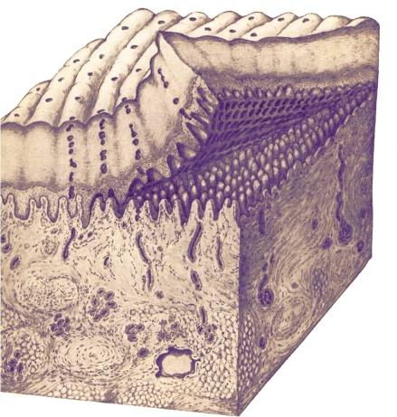
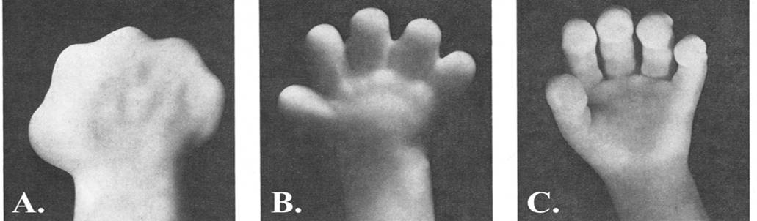
Biological Basis
Friction Ridge Skin is Persistent
  Biological Basis
    Underlying structure and regeneration process
  Empirical Basis
    Observation
    Testing
Friction Ridge Skin is Unique
  Biological Basis
    Embryonic development
  Empirical Basis
    Observation
    Twin studies
    Statistical models
Babler 2005
Ashbaugh 1998
Notes:
Uniqueness and Persistence of friction ridge skin was well-understood before forensic use began in late 1800s and early 1900s
research in time since initial use has supported, and continues to support underlying premises
specific approaches (e.g. point standards) have evolved in response to research, but fundamental practices and premises have remained constant.

Slide 5
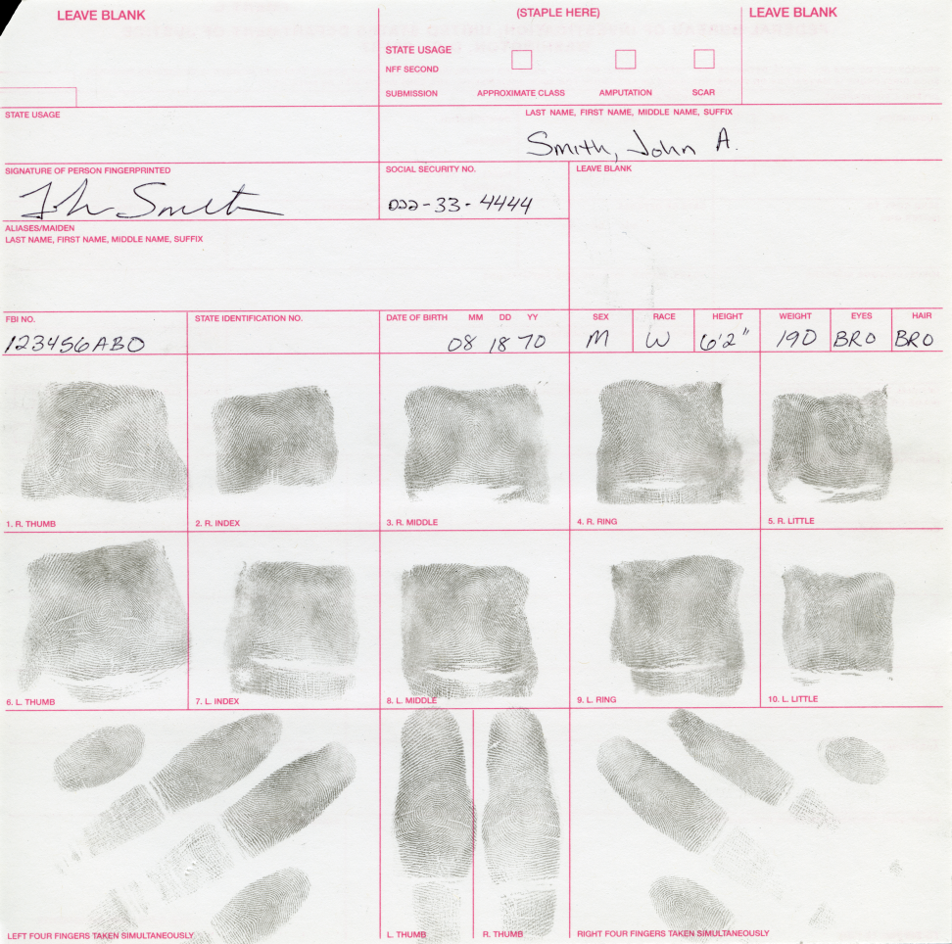
Known Fingerprints
Intentional reproduction of the friction ridge arrangement present on the end joints of the fingers.
Also referred to as:
  Standard 10-print card
  Inked fingerprints
  Known exemplar
Notes:
Fingerprints are often recorded on a standard 10-print card.
Typically recorded using black printer’s ink…
Discuss rolled and plain impressions
These exemplars are what we use to compare to any latent prints detected in our casework.
Explain major case prints

Slide 6
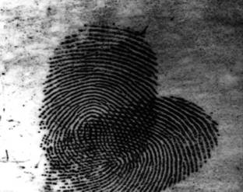
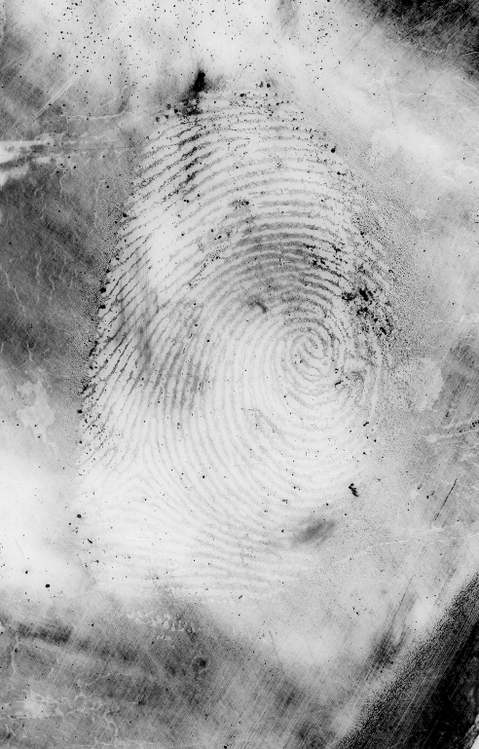
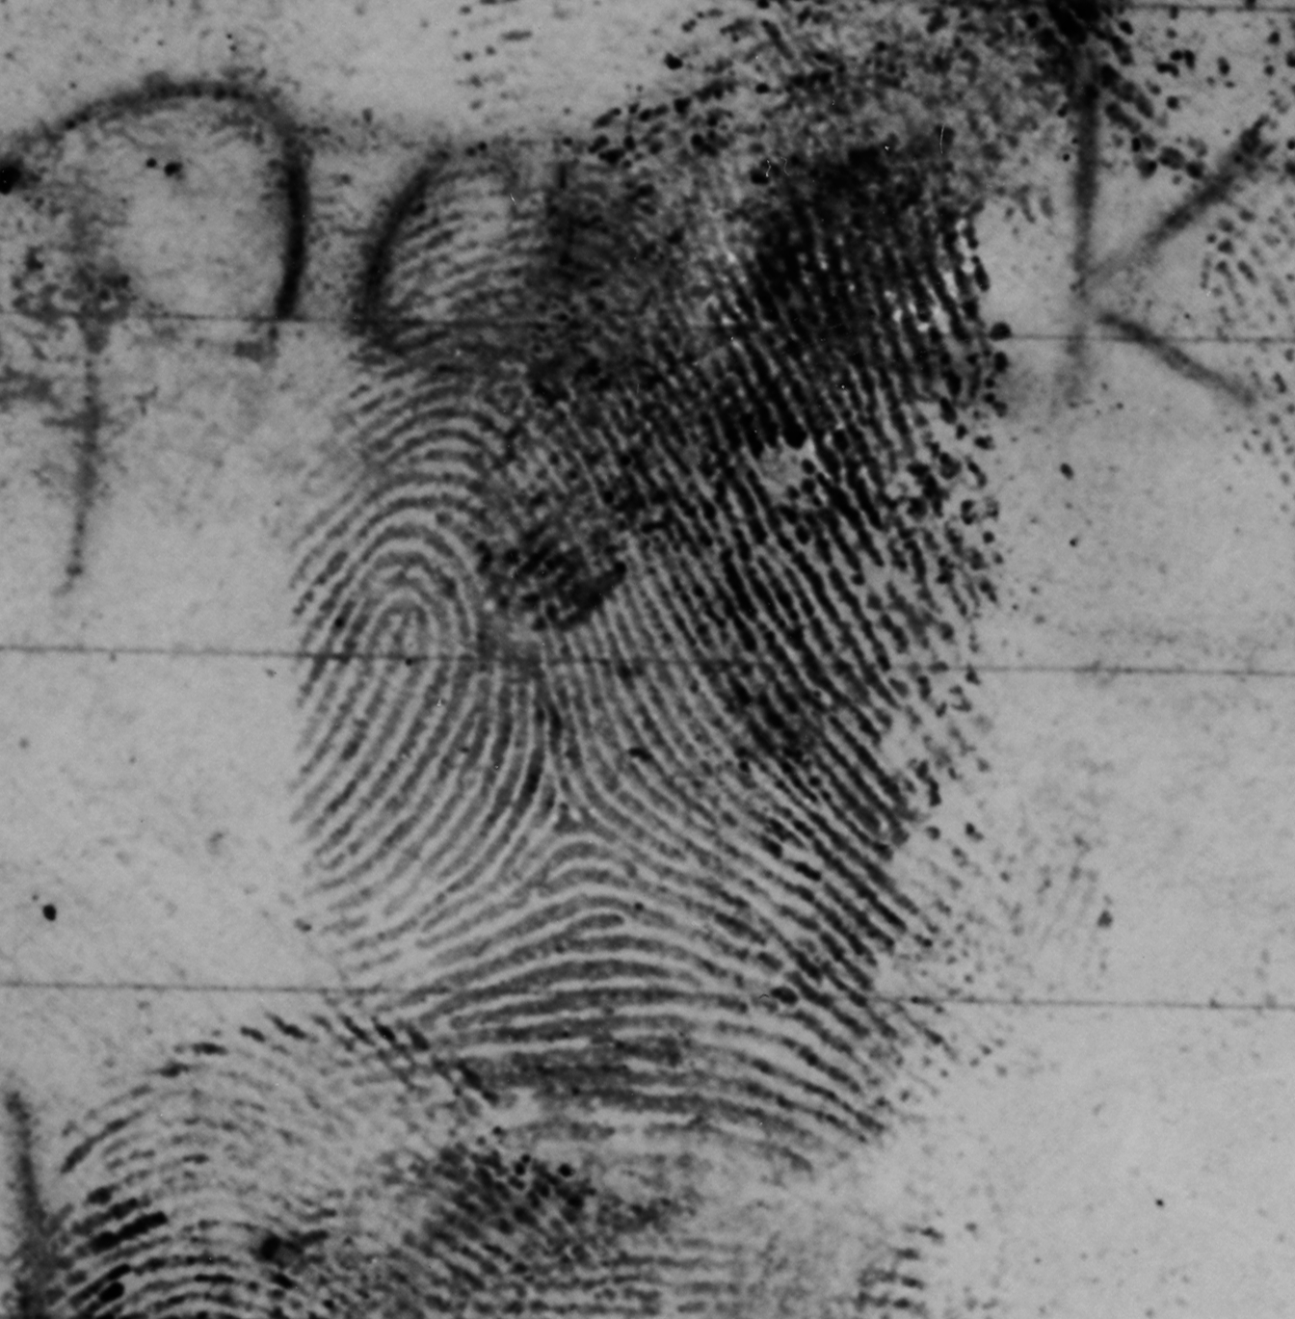
Latent Prints
Reproduction of the friction ridges left behind in perspiration or other material, such as oil, grease, dirt, blood, or paint, that may cover the surface of the ridges.
Also referred to as:
  Unknown prints
  Partial prints
  Patent prints

Slide 7
Comparison Process

Slide 8
Comparison Process
Analysis
Comparison
Evaluation
Verification

Slide 9
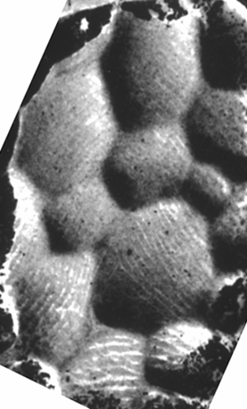
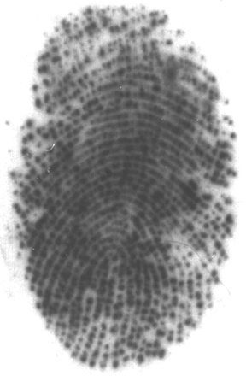
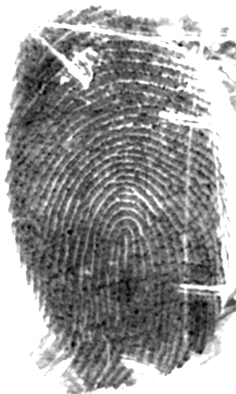
Substrate, Matrix and Development Medium
Substrate is the surface on which a friction ridge impression is deposited
Matrix is the material coating the friction ridges that can be deposited by the finger.
Textured Glass Bottle
Sweat
Development medium is the substance with which the matrix reacts that makes the print visible
Superglue
Notes:
An examiner also needs to understand the how the surface that the print was developed on could affect the appearance of the latent print. If that surface was curved or textured for example, and how that may affect the translation of information from the print.

Slide 10
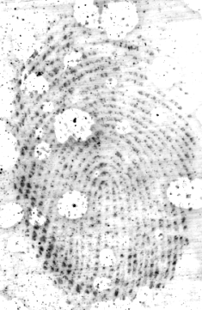
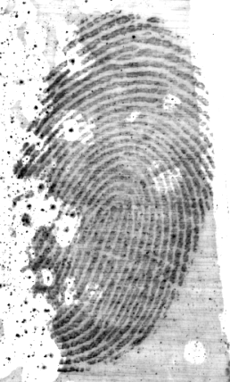
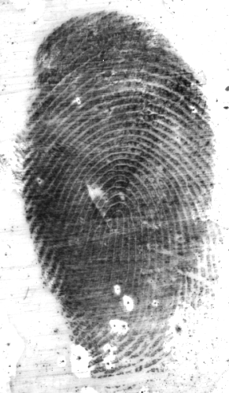
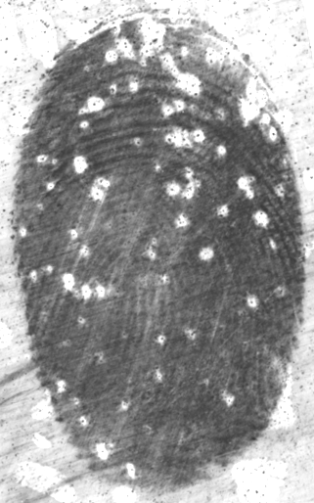
Deposition Pressure
Light
Medium
Heavy
Extreme
Amount of pressure exerted when print is deposited
Notes:
10
Vertical or downward pressure
Affects the width of ridges and edge shapes
Affects the width of furrows
Incipient ridges may fail to appear due to a lack of deposition pressure
During comparison, the resulting wide furrows would be evident.
Measurements between ridge characteristics can be carried out.

Slide 11
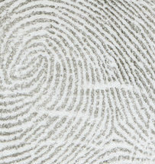
Individual Characteristic Information
Single characteristics contain multiple types of information
  Location
  Type
  Direction
  Spatial Relationship

Slide 12
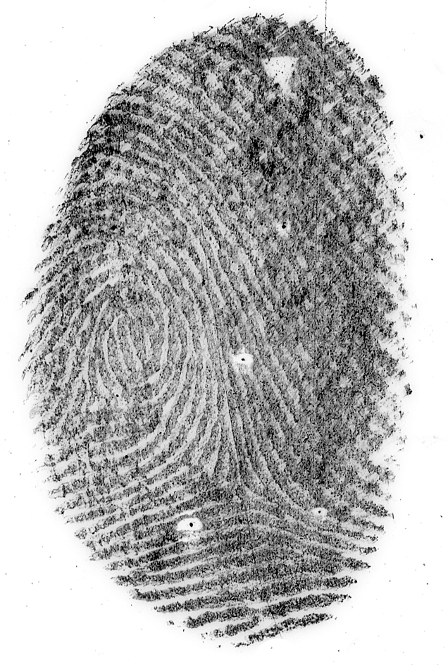
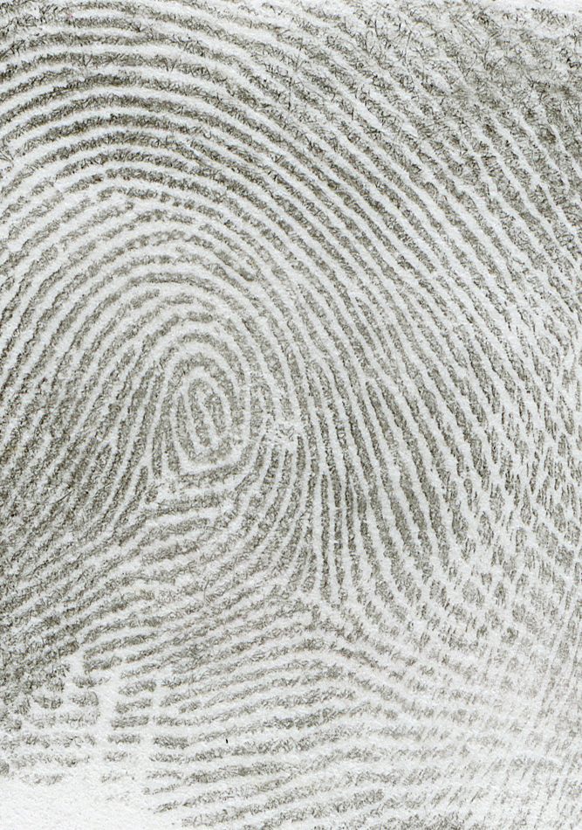
Comparison
UNKNOWN
KNOWN

Slide 13
Three Conclusions of Evaluation
Identification
  The decision by an examiner that there are sufficient features in agreement to conclude that two areas of friction ridge impressions originated from the same source. Identification of an impression to one source is the decision that the likelihood the impression was made by another (different) source is so remote that it is considered as a practical impossibility.
Exclusion
  The decision by an examiner that there are sufficient features in disagreement to conclude that two areas of friction ridge impressions did not originate from the same source.
Inconclusive
  The unknown impression was neither identified nor excluded as originating from the same source.
SWGFAST Standards for Examining Friction Ridge Impressions and Resulting Conclusions
09/13/11 ver. 1.0
Posted: 10/26/11

Slide 14
Verification & Blind Verification
Verification
  Independent application of Analysis, Comparison, and Evaluation by a second examiner.
Blind Verification
  Also an independent application of ACE, but the blind verifying examiner does not know the conclusion of the primary examiner.

Slide 15
Testifying to Verification
New Hampshire v. Langill (2010)
  Defense objected to verification testimony being presented at trial because it was hearsay and violated his right to cross-examine witnesses against him
  Trial court overruled defense objection based upon business records exception
    Trial court concerned that by “…telling the jury that there was some verification here, there is a kind of [sub silentio] implication that the verification is consistent with what Ms. Corson said.”
    But, allowed the testimony anyway.
  NH Supreme Court reversed and remanded
    Agreed that verification testimony is hearsay and therefore inadmissible
15
Notes:
At trial, the defense objected when the prosecutor asked the expert if her work had been verified. Argued that it was hearsay and violated his right to cross-examine witnesses testifying against him.
State argued that the testimony was admissible because it would be based on the expert’s review of documentation from her lab.
Trial court agreed that the verification testimony was hearsay, but overruled the defendant’s objection based upon the business records exception to the hearsay rule, and allowed the expert to testify that her work had been verified. The trial court did have some concerns:
“The only disturbing aspect of it I have here is that obviously by just the – telling the jury that there was some verification here, there is a kind of [sub silentio] implication that the verification is consistent with what Ms. Corson said. And I – that’s a major concern I have…”
15

Slide 16
Madrid Error

Slide 17
Madrid Error
March 2004 terrorists detonated bombs on several commuter trains in Madrid, Spain
Spanish National Police (SNP) developed latent fingerprints on bag of detonators
Submitted images electronically for search in FBI’s automated database
FBI effected identification with Brandon Mayfield
SNP later identified print as an Algerian national (Ouhnane Daoud)
FBI admitted error
Office of the Inspector General (OIG) investigation
Notes:
Give brief background
March 2004 terrorists detonated bombs on several commuter trains in Madrid, Spain
Approximately 200 people killed, more than 1,400 injured
SNP developed latent fingerprints on a bag of detonators connected with the attacks
Sent latent images, through INTERPOL, to FBI Lab for assistance
As a result of an automated search in IAFIS, Brandon Mayfield was identified as the source of one of the prints by the FBI LPU
SNP not convinced of identification
Independent court appointed expert verified Mayfield identification
SNP identified print as an Algerian national (Daoud)
FBI admitted error
Convened International Panel of fingerprint experts to determine cause of error
FBI Lab internal review teams
Office of the Inspector General (OIG) initiated an investigation

Slide 18
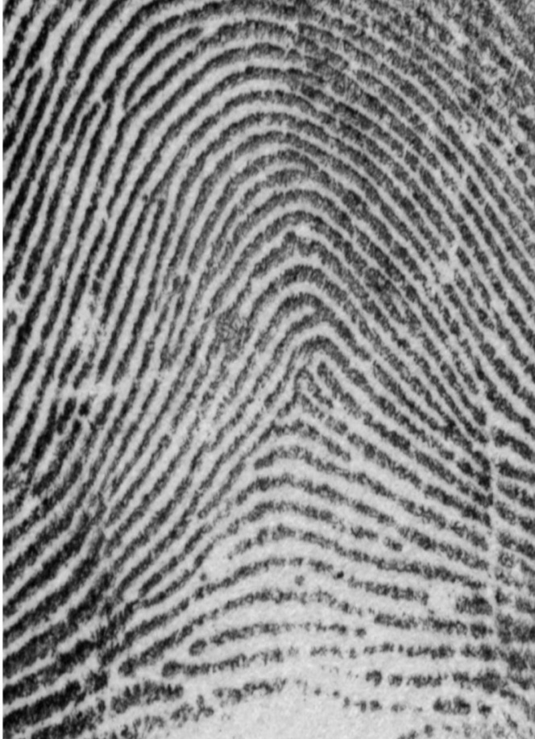
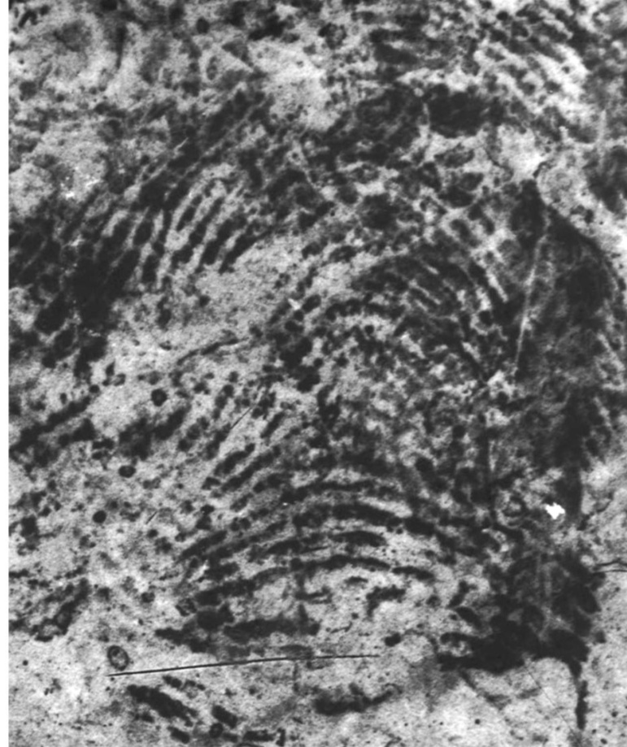
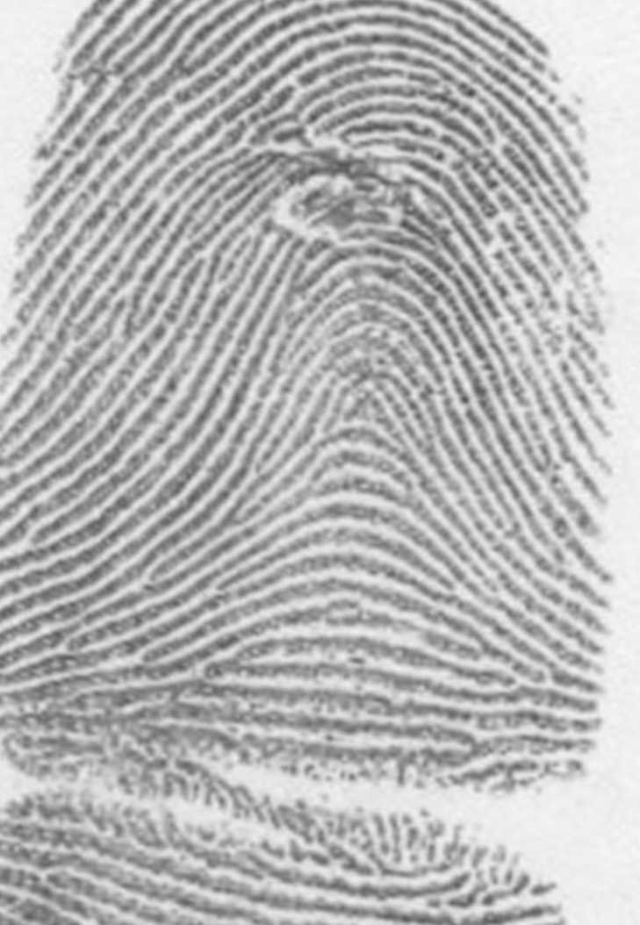
Prints in Question
Mayfield
Latent (LFP 17)
Daoud

Slide 19
OIG Conclusions
OIG Report primary causes of error:
  Examiners failed to properly apply the ACE-V methodology – Practitioner Error
  Bias from known prints (circular reasoning)
  Unusual similarity of the prints (unknown to known) – IAFIS found close non-match
  Faulty reliance on extremely tiny (Level 3) details
  Inadequate explanations for differences in appearance
http://www.usdoj.gov/oig/special/s0601/PDF_list.htm
Notes:
OIG Findings:
Practitioner error, not methodological error
In fact, correct application of ACE-V led to Daoud identification
IAFIS did it’s job – if known print not in system, will find close non-matches
New procedures put into place regarding single IAFIS identifications
Possible bias from known prints – circular reasoning
Initial analysis shown in first set of charts created
Characteristics adjusted in second set of charts created
After comparison with Daoud, original analysis of characteristics shown to be correct

Slide 20
Action Items
Re-examination of certain cases
Revise SOPs
Case documentation
Blind verification policy
Training
Research
Notes:
OIG Progress Review Report Issued June 2011
17 of 18 recommendations closed
Remaining open recommendation deals with ongoing capital case reviews.
OIG and review team recommendations to help prevent future errors
Changes made:
Re-examination of certain cases
All single identification IAFIS cases in LPU – no erroneous idents found
Capital cases
SOPs
Minimum requirements for acceptance of digital images
Expand on ACE-V methodology
IAFIS policy
4 page document to 30+ page document
Cluster prints
Eliminate 12-point rule for supervisor approval
Case documentation
Analysis/Comparison – photos with level 2 characteristics marked retained
Verification – photos with level 2 characteristics marked retained
Blind verification policy
Historical review of erroneous idents
All came from single conclusion cases
Based on this data, FBI LPU instituted policy that all single conclusion cases to be blind verified – give examples
Training
ACE-V training module
Research
Quality metric study
Black box study

Slide 21
Review previous cases
IAFIS reviews
  Cases with a single latent fingerprint identified as a result of an IAFIS search
    Digital image submitted – 16 IAFIS identifications in 14 cases were reviewed and blind verified
    Original evidence submitted – 174 IAFIS identifications were reexamined and blind verified
  No false positives found
Capital offense reviews
  ~ 500 subjects reviewed – 24 had FBI latent print exams – conclusions blind verified – no errors detected
  Ongoing
21
Notes:
21

Slide 22
SOP for Examining Friction Ridge Impressions
More detailed description of each step of ACE-V.
Thorough analysis of latent print must be documented before looking at known print.
Any data relied upon during comparison or evaluation that differs from initial analysis must be separately documented.
Verifiers must separately conduct and document their ACE.

Slide 23
SOP for Examining Friction Ridge Impressions
Confidence that a distortion explanation for a difference must be same degree of confidence needed for an identification.
If Level 3 detail is significantly relied upon to reach a conclusion it must be documented AND
All available known prints on file must be checked to determine if that relied upon Level 3 detail is reliably and consistently reproduced.
23
Notes:
23

Slide 24
Blind Verification Policy
All single conclusions in a submission (identifications, exclusions, and inconclusives)
  Ex. 1 – 10 latent fingerprints detected, 9 of which are identified to person A and 1 is excluded from person A
    The 9 identifications would be verified and the 1 exclusion would be blind verified.
  Ex. 2 – 3 latent fingerprints detected, 1 is identified to person A, 1 is identified to person B, and 1 is identified to person C
    All 3 identifications would be verified and blind verified.
Value decision may also be blind verified
Blind verifier never knows what he is getting

Slide 25
Blind Verification Policy
Supervisor puts together the blind verification packet
Blind verifier receives image(s) of latent print(s) and an envelope that may contain known prints
If the blind verifier determines the print(s) to be of value, he would then open the envelope and compare any known prints.
Blind verifier documents his ACE on the image(s).
Once he has reached a conclusion, the packet is returned to the supervisor.
If there is disagreement between the primary examiner’s conclusion and the blind verifier’s conclusion, then the conflict resolution process would begin.

Slide 26
NAS Report
February 2009

Slide 27
Strengthening Forensic Science in the United States: A Path Forward
National Academy of Sciences
Committee on Identifying the Needs of the Forensic Sciences Community

Slide 28
NAS Recommendations
Congress should establish and appropriate funds for an independent federal entity, the National Institute of Forensic Science
Standard terminology
Research accuracy, reliability, and validity
Remove all public forensic laboratories from the administrative control of law enforcement agencies
Research human observer bias and sources of human error
Standards

Slide 29
NAS Recommendations
Mandate accreditation and certification
Quality assurance and quality control procedures
National code of ethics
Education
  Graduate programs
  Research universities
  Legal community
Medicolegal death investigation
Nationwide fingerprint data interoperability
Homeland security

Slide 30
NAS Report Key Findings
Lack of validity testing
Overstatement of conclusions
Absolute certainty
Lack of statistical support
Lack of standards
Subjectivity
Error rates, sources of error
Lack of scientific culture
Cognitive bias
Notes:
30

Slide 31
NIST Report
Expert Working Group on Human Factors in Latent Print Analysis
February 2012

Slide 32
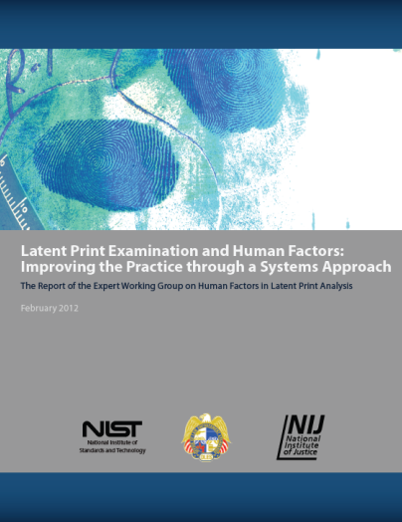
Expert Working Group on Human Factors in Latent Print Analysis
Funded by NIJ’s Office of Investigative and Forensic Sciences and NIST’s Law Enforcement Standards Office
Charged with developing an understanding of the role of human factors and their contributions to errors in latent print analysis, evaluating approaches to reducing these errors, and making recommendations to researchers and policymakers
Expert Working Group on Human Factors in Latent Print Analysis
Notes:
Working Group: Abbreviated Charge
The Working Group was charged with:
• Developing an understanding of the role of human factors and their contributions to errors in latent print analysis through an evidence-based review of literature, case studies, and previous analyses;
• Evaluating approaches to reducing errors in terms of their efficacy, appropriateness in different settings and circumstances, cost, scientific basis, feasibility, institutional barriers to implementation, associated risks, and the quality of evidence supporting the approach;
• Providing guidance to the latent print analysis community on the practical, scientific, and policy outcomes of its work through peer-reviewed publications, presentations at conferences and meetings, and government-sponsored publications;
• Providing guidance to policy-makers and government agencies in promoting a national agenda for error reduction in latent print analysis;
• Attempting to develop credible estimates of the incidence, severity, and costs of errors; and
• Making recommendations for future research.

Slide 33
Working Group Members
The Working Group consisted of experts from forensic disciplines, statisticians, psychologists, engineers, other scientific experts, legal scholars, and representatives of professional organizations.
  Forensic professionals: 17
  Professional Organization Representatives: 4
  Statisticians: 3
  Legal Scholars: 4
  Psychologists: 3
  Other Scientists/Researchers: 3
  Staff: 2
Expert Working Group on Human Factors in Latent Print Analysis
Notes:
Segment 1: Working Group.
Discuss the inter-disciplinary nature of the WG.

Slide 34
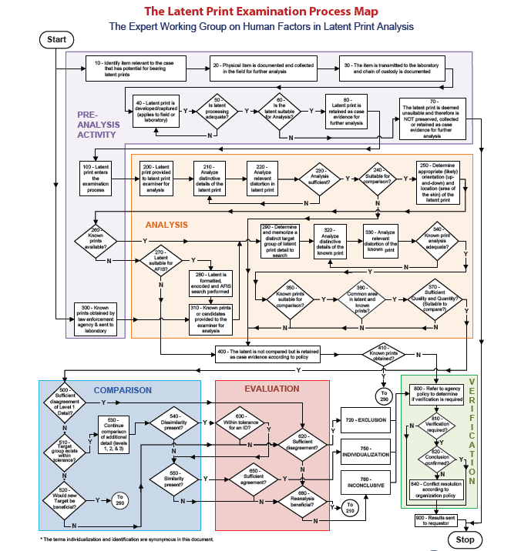
ACE-V
ACE-V defines the steps of the latent print examination process, as detailed in the process map developed by the Working Group:
  Analysis
  Comparison
  Evaluation
  Verification
Expert Working Group on Human Factors in Latent Print Analysis
Notes:
ACE-V: The Process Map
In broad strokes, a latent print examination using the ACE-V process proceeds as follows: Analysis refers to an initial information-gathering phase in which the examiner studies the unknown print to assess the quality and quantity of discriminating detail present. The examiner considers information such as substrate, development method, various levels of ridge detail, and pressure distortions. A separate analysis then occurs with the exemplar print. Comparison is the side-by-side observation of the friction ridge detail in the two prints to determine the agreement or disagreement in the details. In the Evaluation phase, the examiner assesses the agreement or disagreement of the information observed during Analysis and Comparison and forms a conclusion. Verification in some agencies is a review of an examiner’s conclusions with knowledge of those conclusions; in other agencies, it is an independent re-examination by a second examiner who does not know the outcome of the first examination.

Slide 35
Latent Print Examination and Human Factors:
Improving the Practice through a Systems Approach
Report Chapters:
  The Latent Print Examination Process and Terminology
  Human Factors and Errors
  Interpreting Latent Prints
  Looking Ahead to Emerging and Improving Technology
  Reports and Documentation
  Testimony
  A Systems Approach to the Work Environment
  Training and Education
  Human Factors Issues for Management
  Summary of Recommendations
Expert Working Group on Human Factors in Latent Print Analysis
Notes:
Working Group: Report Chapters

Slide 36
Human Factors in Interpretation
Some human factors can affect all stages of the latent print examination process.
Bias: Minimize the effect of contextual information by keeping irrelevant information from the examiner.
Documentation: Make notes and reports as transparent as possible to enable
repeatability.
Expert Working Group on Human Factors in Latent Print Analysis
Notes:
ACE-V: Potential issues
One crosscutting issue is the need for adequate documentation of an examiner’s reasoning and conclusions. Documentation is not itself an interpretive practice, but rather a practice for capturing an examiner’s interpretive judgments in a form that would permit the examiner, or another examiner, to make sense of a decision at a later time. Documentation serves to maximize the transparency of the interpretative process and to provide a record that can be useful for many purposes, including reports and testimony, future research and evaluation, and quality assurance. Documentation requirements also may affect the interpretive process itself by requiring judgments to be explicit and thus potentially subject to greater reflection on the part of the examiner.
Another crosscutting issue is cognitive bias. There is a substantial body of psychological research illustrating the tendency for human beings to engage in motivated reasoning or to be affected by contextual knowledge. Even people attempting to be fair interpreters of the evidence may be influenced by information outside the formally relevant decision criteria. Such biases may be present in the work of latent print examiners. However, the extent to which cognitive bias creates the danger of erroneous interpretations in real-world circumstances has not yet received significant research attention. Continued research about the presence or absence of such biases in the latent print domain and the extent of any impact on accuracy and reliability is needed. However, given the decades-long research into the significant effects of cognitive bias in other domains, it seems wise to minimize the potential for such biases in latent print interpretation, even in the absence of definitive research results for latent print analysis.
Recommendation 3.6: When comparing latent prints to exemplars generated through AFIS searches, examiners must recognize the possibility and dangers of incidental similarity. Adjustments such as a higher decision threshold, stricter tolerances for differences in appearance, and explicit feature weighting need to be considered. Modifying quality assurance practices for this scenario also should be considered.

Slide 37
Research Needs
The Working Group identified several areas that require additional research, including:
The effect of cognitive bias on examiners’ reliability
Human factors issues related to the interpretation of latent print evidence
Examiners’ ability to determine suitability and sufficiency
Automated quality determination
Probabilistic models to report qualified conclusions with a scientific basis
AFIS technology and interoperability improvements
Expert Working Group on Human Factors in Latent Print Analysis
Notes:
Research Topics: General Research Needs
The issue of cognitive bias is one important topic in the study of human factors in friction ridge impression examination. Research on expectancy effects in latent print identification is limited. However, being consistent with widely accepted psychological phenomena, this research has prompted proposals for blinding forensic examiners to the origin of samples being compared with each other and for using multiple exemplars in comparisons. Likewise, blind verification shields the verifying examiner from contextual bias that might otherwise affect the outcome in difficult cases. The Noblis-FBI experiment indicated “that blind verification of exclusions could greatly reduce false negative errors.” Taking the human factors perspective, an agency might wish to adopt one or more of these systemic changes rather than simply warning examiners to do their best not to be influenced by potentially biasing information.
A handful of studies have assessed variation in the feature selection process. Generally, they find a wide variation among examiners during the task of feature selection. At this stage, what may be of more interest to the community are methods to reduce the variation of feature selection and tools and technologies to help identify the most reliable features.
The link between variations in feature selection and the examiner’s ultimate decision is not well understood. Emerging research suggests that there is a relationship, but the effect may be competing with other major interpretative steps.
It is of great interest to understand the degree to which utility determinations are reliable.
A wide range of factors can affect utility determinations. One possible topic for consideration is context effects: does the type of case (e.g., violent crime versus property crime) have an effect on the determination of utility, or does background knowledge about the case affect utility judgments?
The relationship between the culture and expectations in an agency and examiner performance has not been studied.
Research could investigate whether certain pattern types create different utility strategies in relation to searching manually or on AFIS.
There is a strong need for systematic studies pertaining to the reproducibility and discriminating strength of fingerprint features. More specifically, although the prevalence of particular L1D features is well documented, a more complete understanding of the dependencies in these features between fingers is desirable. Regarding L2D features, there is limited research that would allow a global assessment (without strong independence assumptions) of the strength of minutiae configurations. Likewise, the information power of L3D features is not fully understood nor has it fully been explored for forensic use. Limited systematic studies have been carried out on features such as creases, lines, and scars, which are useful to support the evaluation process when these features are present. These studies should take into account variables such as sex, finger number, pattern, and race.
Studies to measure the variability of distortion and the extreme limits of distortion are needed.
An examiner’s ability to identify types of distortion has not been thoroughly studied. Research is needed not only to determine if an examiner’s working assumptions regarding the effects and degree of distortion have an empirical basis but also to determine if, or in what circumstances, a misattribution of distortion may lead to an incorrect conclusion.
There has been little research in the fingerprint domain to determine the extent to which contextual information affects the interpretation of dissimilarities. More research is needed to determine when various context effects, such as confirmation bias, may lead to erroneous conclusions.
Research in the latent print domain in past decades has largely been centered on automated fingerprint identification systems and physical and chemical detection techniques. Very little research, until the last few years, has centered on human performance in pattern recognition and interpretation. Much more research is needed not only to validate ideas being put forward today but also to expand understanding further.
Probability models date back to Galton’s 1892 model. Modern efforts to determine the probability of correct latent print identification are based upon determining the locations of minutiae, of minutiae and ridges, and even of pores. These models incorporate measures of tolerance in accounting for skin distortion and the degradation of crime scene impressions. To date, research into probability models has been limited to the distal segments of the fingers; the remainder of the friction ridge skin has not been considered. A useable probabilistic model could significantly affect the methods of latent print examination. First, the model might require new metrics in latent print images, that is, the documentation and measurement of new features. Some of the current models rely on measurements that many examiners do not take, such as the distance between friction ridge features. If measurements and the computation can be automated, then the use of the model could reduce the risk of human error in making and using such measurements.
In the experience of the Working Group, this initial quality assessment of the latent print is often the weak link in the analytical process, as examiners could make two types of errors.
Currently available automated systems can assist in various steps within the Analysis phase. Automated systems can measure the distance between certain features in two images. They can also generate probabilities for such distances under the assumptions that the image of the latent print comes from a finger known to have produced an exemplar and that the latent comes from a finger of a randomly selected individual represented in a reference set of exemplars from many individuals. Such conditional probabilities might be used in their own right or to corroborate or contradict the judgment of a human examiner. Thus, an automated technique employing a validated algorithm for judging the quality of an image and its suitability for forensic identification would be extremely useful.

Slide 38
Summary
In its report, the Working Group endeavored to highlight human factors that could be affecting latent print examiners and to provide solutions to minimize these effects.
The full report, Latent Print Examination and Human Factors: Improving the Practice through a Systems Approach, is available at www.nist.gov/oles/.
Additional related NIJ research reports can be found http://www.nij.gov/nij/topics/forensics/evidence/impression/projects-friction-ridge.htm
Expert Working Group on Human Factors in Latent Print Analysis
Notes:
Summary

Slide 39
Hot Topics
Error Rate
Validity Testing
Absolute Certainty
“To the exclusion of all others”
Bias
39

Slide 40
Error Rate
What is the error rate for friction ridge comparisons?
  Inappropriate to claim a zero error rate in the practice of the method.
  Important to not dismiss the fact that there is always the chance of human error.
40

Slide 41
Types of Errors
Technical Errors – associated with data interpretation
  False positive (erroneous identification)
    Falsely identifying someone as the source of a latent print
  False negative (erroneous exclusion)
    Falsely excluding someone as the source of a latent print
Administrative Errors – not associated with data interpretation
  Clerical errors (e.g. typographical, transcription)
Notes:
41
Need to discuss errors before reliability studies???

Slide 42
Validity Testing
Has ACE-V been validated?
Are examiners reaching reliable conclusions?
42

Slide 43
Accuracy & Reliability of Forensic Latent Fingerprint Decisions
“Black Box” study
169 examiners presented with ~100 image pairs resulting in 17,121 total decisions
Positive Predictive Value = 99.8%
  When examiners said identification, they were right 99.8% of the time.
False Positive Rate = 0.1%
  0.1% of comparisons of non-mated pairs resulted in identification decisions (false positives)
  6 total false positives
  No two examiners made the same false identification
Ulery, B.T.; Hicklin, A.R.; Buscaglia, J.; and Roberts, M.A. (2011). Accuracy and Reliability of Forensic Latent Fingerprint Decisions. Proceedings of the National Academy of Sciences 108(19): 7733-7738.
Notes:
The Good:
Positive Predictive Value = 99.8%
Percentage of identification decisions that are correct.
Meaning, when examiners said that it was an identification, they were right 99.8% of the time.
False Positive Rate = 0.1%
Percentage of the comparisons between non-mated prints that result in an erroneous identification conclusion.
Among the 4,083 comparisons where the latent was determined to be of value for identification (VID), 6 false positives occurred (FPR_{VID} = 0.1%)
2 involved a single latent, but with exemplars from different subjects
4 of the 5 distinct latents were deposited on a galvanized metal substrate, which was processed with SGF and light gray powder (often partially or fully tonally reversed)
The 6 errors were committed by 5 examiners
No two examiners made the same false identification. This implies that the false identifications would have been caught if blind verified.
When examiners reached contradictory conclusions (id vs. exclusion) on a single comparison, the exclusion decision was more frequently in error
The Bad:
Negative Predictive Value = 86.6%
Percentage of exclusion decisions that are correct.
Meaning, when examiners said that it was an exclusion, they were right 86.6% of the time.
False Negative Rate = 7.5%
Percentage of the comparisons between mated prints that result in an erroneous exclusion decision.
7.5% of comparisons of mated pairs resulted in exclusion decisions (false negative)
Adding in of value for exclusion (VED) comparisons had no substantial effect (FNR_{CMP}=7.5% as well)
85% of examiners made at least one false negative error
False negatives were distributed across half of the image pairs that were compared
BV of exclusions could greatly reduce false negative errors even though some were falsely excluded by multiple examiners (see paper for full explanation)
The Ugly:
Consensus (or lack thereof)
Each image pair was examined by an average of 23 participants
Of mated pair decisions, 10% were unanimous true positives, 38% were unanimous inconclusives
Of non-mated pair decisions, 25% were unanimous true negatives, 9% were unanimous inconclusives
For unanimous decisions, the images were the driving factor – unusable or pristine prints resulted in unanimous decisions
Examiners differed significantly in conclusion rates (reaching a definitive conclusion of identification or exclusion vs. inconclusive or no value) which affects overall effectiveness
Important to note:
Results are not representative of all casework situations
Operational processes , like verification and review policies, may include additional steps to reduce the possibility of error
Image pairs were selected to be challenging
Mated pairs were randomly selected from the multiple latents and exemplars available for each finger position
Non-mated pairs were based on difficult comparisons resulting from searches of IAFIS
Limited image processing
Could not skip or revisit previous comparisons
What’s next:
Further research to identify the attributes of prints associated with errors (quality, distortion, background, etc.)
Consensus data can help define quality and quantity metrics for sufficiency
Repeatability phase of study to be published

Slide 44
Accuracy & Reliability of Forensic Latent Fingerprint Decisions
Negative Predictive Value = 86.6%
  When examiners said exclusion, they were right 86.6% of the time.
False Negative Rate = 7.5%
  7.5% of comparisons of mated pairs resulted in exclusion decisions (false negatives)
85% of examiners made at least one false negative error
Ulery, B.T.; Hicklin, A.R.; Buscaglia, J.; and Roberts, M.A. (2011). Accuracy and Reliability of Forensic Latent Fingerprint Decisions. Proceedings of the National Academy of Sciences 108(19): 7733-7738.
Notes:
The Good:
Positive Predictive Value = 99.8%
Meaning, when examiners said that it was an identification, they were right 99.8% of the time.
False Positive Rate = 0.1%
Among the 4,083 comparisons where the latent was determined to be of value for identification (VID), 6 false positives occurred (FPR_{VID} = 0.1%)
2 involved a single latent, but with exemplars from different subjects
4 of the 5 distinct latents were deposited on a galvanized metal substrate, which was processed with SGF and light gray powder (often partially or fully tonally reversed)
The 6 errors were committed by 5 examiners
No two examiners made the same false identification. This implies that the false identifications would have been caught if blind verified.
When examiners reached contradictory conclusions (id vs. exclusion) on a single comparison, the exclusion decision was more frequently in error
The Bad:
Negative Predictive Value = 86.6%
Meaning, when examiners said that it was an exclusion, they were right 86.6% of the time.
False Negative Rate = 7.5%
7.5% of comparisons of mated pairs resulted in exclusion decisions (false negative)
Adding in of value for exclusion (VED) comparisons had no substantial effect (FNR_{CMP}=7.5% as well)
85% of examiners made at least one false negative error
False negatives were distributed across half of the image pairs that were compared
BV of exclusions could greatly reduce false negative errors even though some were falsely excluded by multiple examiners (see paper for full explanation)
The Ugly:
Consensus (or lack thereof)
Each image pair was examined by an average of 23 participants
Of mated pair decisions, 10% were unanimous true positives, 38% were unanimous inconclusives
Of non-mated pair decisions, 25% were unanimous true negatives, 9% were unanimous inconclusives
For unanimous decisions, the images were the driving factor – unusable or pristine prints resulted in unanimous decisions
Examiners differed significantly in conclusion rates (reaching a definitive conclusion of identification or exclusion vs. inconclusive or no value) which affects overall effectiveness
Important to note:
Results are not representative of all casework situations
Operational processes , like verification and review policies, may include additional steps to reduce the possibility of error
Image pairs were selected to be challenging
Mated pairs were randomly selected from the multiple latents and exemplars available for each finger position
Non-mated pairs were based on difficult comparisons resulting from searches of IAFIS
Limited image processing
Could not skip or revisit previous comparisons
What’s next:
Further research to identify the attributes of prints associated with errors (quality, distortion, background, etc.)
Consensus data can help define quality and quantity metrics for sufficiency
Repeatability phase of study to be published

Slide 45
Absolute Certainty
Are you 100% certain of the identification?
  The certainty often associated with an identification is a measure of the examiner’s confidence in his or her opinion based on the data observed, and not a statement of absolute scientific truth.
45
Notes:
The absolute certainty question is something that has really been brought about by the legal system. When asked about my results…
Q: Ms. Gische, what were the results of your comparisons?
A: I don’t testify to an identification by saying that “I am absolutely 100% certain that I identified the latent print detected on…”
The certainty question is usually brought out by the attorney.
If an examiner had any doubt, they wouldn’t reach an identification decision. Studies have shown that examiners more often err on the side of caution (higher occurrence of false exclusions than false identifications) (Langenburg, Black Box)
So, when an examiner is asked if they are certain of their conclusion, they are going to express the highest level of confidence (particularly with an identification conclusion).
I’m not stating that this is an absolute scientific fact, but with everything I know about fingerprints, after a careful analysis of the data, and a trip through a robust quality system, I am confident in the quality and accuracy of my examination.

Slide 46
“To the exclusion of all others”
Can latent prints be attributed to a particular source to the exclusion of all other sources?
How do you know, with absolute certainty, that there isn’t another area of friction ridge skin on another individual that could have left a similar looking latent print?
  Until we have a way to quantify sufficiency, examiners must recognize the hypothetical chance that another area of friction ridge skin could have left a similar looking latent.
  If there’s a realistic chance of this happening, it’s most likely going to be with a borderline print near the sufficiency threshold.
46
Notes:
As a discipline, we have to be prepared to explain this concept.
FBI Standard for Identification - “Identification is the decision by a qualified examiner that there is sufficient friction ridge detail in agreement to conclude that two friction ridge prints originated from the same source. This decision is made when the examiner would not expect to see this amount of information in agreement from two prints that did not originate from the same source.”

Slide 47
Standard for Identification - SWGFAST
“The decision by an examiner that there are sufficient features in agreement to conclude that two areas of friction ridge impressions originated from the same source. Identification of an impression to one source is the decision that the likelihood the impression was made by another (different) source is so remote that it is considered as a practical impossibility.”
SWGFAST Standards for Examining Friction Ridge Impressions and Resulting Conclusions
09/13/11 ver. 1.0
Posted: 10/26/11
47
Notes:
47

Slide 48
Bias
Can latent print examiners be affected by bias?
  Potential for bias with any cognitive process
  Does not necessarily lead to error
  Awareness → Training → QA measures
48

Slide 49
Ensuring Quality
Qualifications of Examiner
  Training
    duration
    comparisons
  Qualification/Certification
    Internal
    External
  Proficiency Tests
    Internal
    External (CTS)
  Past Performance
    personnel records
Qualifications of Laboratory
  Accreditation
    ISO 17025
  Quality System
    SWGFAST guidelines and standards
    Verification policy
    Technical & Administrative Reviews
    Case file audits

Slide 50
Questions?

