Slide 1
Evidence Preservation and Storage
D. Jody Koehler, M.S.
DNA Section Manager
Texas Department of Public Safety
Crime Laboratory Service Austin

Slide 2
Evidence Preservation and Storage
Scope
  DPS was tasked with creating uniform rules with regards to handling biological evidence
    These rules went into effect October 30, 2012
  Defining/Categorizing evidence (ex. DNA, Trace, Toolmark)
    Primary focus on biological evidence
  Considerations when handling evidence
  Proper storage
    Facility – space, environmental controls, and security
    Packaging
  Tracking
    Chain-of-Custody
  Destruction of Evidence
  Best Practices

Slide 3
Legislation
Ensures preservation of evidence containing biological material
Statute of limitations for sex crimes with biological evidence is indefinite
Allows convicted offenders to submit a motion for DNA testing

Slide 4
Code of Criminal Procedure
Art. 38.43. PRESERVATION OF EVIDENCE CONTAINING BIOLOGICAL MATERIAL
A governmental or public entity or an individual, including a law enforcement agency, prosecutor's office, court, public hospital, or crime laboratory, that is charged with the collection, storage, preservation, analysis, or retrieval of biological evidence
shall ensure that biological evidence collected pursuant to an investigation or prosecution of a felony offense or conduct constituting a felony offense is retained and preserved.

Slide 5
Code of Criminal Procedure
Art. 38.43. PRESERVATION OF EVIDENCE CONTAINING BIOLOGICAL MATERIAL
This article applies biological evidence
  (1) collected pursuant to an investigation or prosecution of a felony offense or conduct constituting a felony offense that
  (2) might reasonably be used to
    establish the identity of the person committing the offense or engaging in the conduct constituting the offense; or
    exclude a person from the group of persons who could have committed the offense or engaged in the conduct constituting the offense.

Slide 6
Biological evidence…….
What is it?
1. The contents of a sexual assault examination kit; or
2. Any item that contains blood, semen, hair, saliva, skin tissue, fingernail scrapings, bone, bodily fluids, or any other identifiable biological material that was collected as part of an investigation of an alleged felony offense or conduct constituting a felony offense

Slide 7
Code of Criminal Procedure
Art. 38.43. PRESERVATION OF EVIDENCE CONTAINING BIOLOGICAL MATERIAL.
(c) Except as provided by Subsection (d), material required to be preserved under this article must be preserved:
(1) until the inmate is executed, dies, or is released on parole, if the defendant was convicted of a capital felony; or
(2) until the defendant dies, completes the defendant's sentence, or is released on parole or mandatory supervision, if the defendant is sentenced to a term of confinement or imprisonment.

Slide 8
Code of Criminal Procedure
Art. 2.21. Duty of Clerks
Art. 2.21. DUTY OF CLERKS.
(a) In a criminal proceeding, a clerk of the district or county court shall: (1) receive and file all papers; (2) receive all exhibits at the conclusion of the proceeding; (3) issue all process; (4) accept and file electronic documents received from the defendant, if the clerk accepts electronic documents from an attorney representing the state; (5) accept and file digital multimedia evidence received from the defendant, if the clerk accepts digital multimedia evidence from an attorney representing the state, and (6) perform all other duties imposed on the clerk by law.
(b) At any time during or after a criminal proceeding, the court reporter shall release for safekeeping any firearm or contraband received as an exhibit in that proceeding to: (1) the sheriff; or (2) in a county with a population of 500,000 or more, the law enforcement agency that collected, seized, or took possession of the firearm or contraband or produced the firearm or contraband at the proceeding.

Slide 9
Code of Criminal Procedure
Art. 2.21. Duty of Clerks
(c) The sheriff or the law enforcement agency, as applicable, shall receive and hold the exhibits consisting of firearms or contraband and release them only to the person or persons authorized by the court in which such exhibits have been received or dispose of them as provided by Chapter 18.
(d) In this article, "eligible exhibit" means an exhibit filed with the clerk that: (1) is not a firearm or contraband; (2) has not been ordered by the court to be returned to its owner; and (3) is not an exhibit in another pending criminal action.

Slide 10
Code of Criminal Procedure
Art. 2.21. Duty of Clerks
An eligible exhibit may be disposed of as provided by this article:
  on or after the 1st anniversary of the date on which a conviction becomes final in the case, if the case is a misdemeanor or a felony for which the sentence imposed by the court is 5 years or less;
  on or after the 2nd anniversary of the date on which a conviction becomes final in the case, if the case is a non-capital felony for which the sentence imposed by the court is greater than 5 years;
  on or after the 1st anniversary of the date of the acquittal of a defendant; or
  on or after the 1st anniversary of the date of the death of a defendant.

Slide 11
“So how do I know what to keep and how to store it?”

Slide 12
Defining the Evidence
What is Physical Evidence?
  “…any and all objects that can establish that a crime has been committed or can provide a link between a crime and its victim or a crime and its perpetrator.”
  - Richard Saferstein, Criminalistics: An Introduction to Forensic Science, 7th ed

Slide 13
Defining the Evidence
Examples of biological evidence
  Blood, semen, saliva, other body fluids, skin cells…
  Sexual assault kits from suspects and/or victims
  Hair
  Clothing, hats, masks, eyeglasses, jewelry, gloves from involved individuals
  Ligatures such as ropes, belts, tape, and cords
  Bedding such as sheets, blankets, comforters, pillow cases, etc
  Towels, used tissues, toilet paper, and paper towels
  Condoms
  Cigarette butts, cups, cans, and bottles
  Biological standards such as buccal swabs from
  individuals involved
  Whole blood from DWI suspects are NOT considered
  biological evidence

Slide 14
Other Evidence
Trace Evidence
  May already be lost after initial examinations or has already been preserved by the laboratory
  For the purpose of preserving for future (post-conviction) testing this will most likely be hair or fingernail scrapings that can be used for DNA testing

Slide 15
Evidence Handling
  Governing principle in Forensic Science…
  “Every contact leaves a trace”
    Locard’s Exchange Principle

Slide 16
Evidence Handling
We want to ensure that evidence and materials are collected in a manner that prevents contamination and degradation and ensures integrity during all phases of the investigation and litigation.

Slide 17
Evidence Handling
That means that YOUR handling or any handling that takes place in the courtroom or after trial can alter or destroy the physical evidence
The attorneys, clerks, or even jurors can through contact with exhibits deposit physical evidence

Slide 18
Evidence Handling
Post-conviction cases
  The lab often re-examines evidence to rule out a convicted individual and/or to enter any DNA profile into the DNA database to generate an investigative lead
  DNA has been recovered from items of evidence handled during trial that matched one of the attorneys

Slide 19
Evidence Handling
Protect the evidence
Protect yourself
Personal safety and the prevention of evidence contamination go hand-in-hand

Slide 20
Universal Precautions Against Bloodborne Pathogens
  In 1991, the Occupational Safety and Health Administration (OSHA) issued Title 29, part 1910.1030 of the Code of Federal Regulations (CFR), Occupational Exposure to Bloodborne Pathogens (BBP).
  Bloodborne pathogens are defined as “pathogenic microorganisms that are present in human blood and can cause disease in humans. These pathogens include, but are not limited to, hepatitis B virus (HBV), hepatitis C virus (HCV), and human immunodeficiency virus (HIV)

Slide 21
Universal Precautions Against Bloodbourne Pathogens
  This standard forms the primary mechanism for infection control.
  All human blood, body fluids, or other potentially infectious material must be treated as if infected with hepatitis B virus (HBV), hepatitis C virus (HCV), and human immunodeficiency virus (HIV).
    A vaccine exists that may provide some protective from HBV, but no such vaccine exists for either HCV or HIV. It is recommended that persons in professions with potential contact with BBP, receive HBV vaccinations. Measures must be taken to avoid direct or indirect contact with potentially infectious materials.

Slide 22
Routes of Exposure
Whether the hazard is biological or chemical in nature, the primary routes of exposure are the same.
By being aware of how an exposure can occur, the correct decisions can be made with regards to the proper protective equipment that should be worn and how to properly clean and decontaminate after exposure.
The most effective way to clean collection equipment and surfaces is with a 10% bleach solution (10 parts water to 10 parts bleach).

Slide 23
Routes of Exposure
Inhalation
Both pathogens and chemicals can enter the body via inhalation. Examples include pathogens like anthrax or the flu. Volatile chemicals or aerosolized chemicals like luminol can also be inhaled.
Contact
with the skin or mucus membranes- Chemicals can cause local irritation, redness, swelling, burning or damage to the contact tissues. Severity of the reaction depends on the type and concentration of the chemical, and duration of exposure. Systemic effects can be as minor as dizziness and nausea, and as extreme as organ damage, shock and unconsciousness.
Ingestion
Ingested corrosive materials can damage the mouth, throat, and digestive tract. Ingested toxic chemicals are usually absorbed by the body via the stomach and intestines. Regular hand washing and prohibiting the consumption or presence of food or drink in contamination prone areas, including the crime scene, will minimize exposure to chemicals or biological contaminants.
Injection
Needle sticks and mechanical injuries from contaminated glass, metal, or other sharp objects can introduce biological contaminants directly into the bloodstream.

Slide 24
Personal Protective Equipment (PPE)
One of the primary means of defense against exposure is the use of barrier protection such as:
    disposable Latex or Nitrile gloves
    Coveralls
    Labcoats
    Surgical masks
    shoe-covers

Slide 25
Personal Protective Equipment
  Barrier protectants, like latex gloves, do not provide the same type of protection once they have been exposed.
  The use of hand lotions or even sweat can also break down the latex.
  Change gloves frequently even if they have not had direct contact with a biological or chemical contaminant.

Slide 26
Personal Protective Equipment
  Change exposed gloves as soon as possible.
  Gloves should also be inspected before and during wear for tears or holes.
  Dried blood can also flake, so the same type of protective equipment should be used. Surgical masks or well-fitting respirators can be worn when there is potential for contamination or transfer from airborne biohazards or chemicals.

Slide 27
Evidence Handling
Protect the evidence
Protect yourself
  Wear Gloves at a minimum
  Wear a surgical mask

Slide 28
Separation, Packaging, Labeling, and Storage

Slide 29
Separation
  Store “questioned evidence” in a separate container from reference samples.
  Store “questioned evidence” from the victim and/or the crime scene in separate containers from evidence collected from the suspect.
*Change gloves – DO NOT wear the same gloves when handling questioned evidence from different sources or reference samples

Slide 30
Packaging and Labeling
The following discussion applies to items of evidence that require repackaging
If the original packaging is intact and sealed – leave it that way
    Preserve the integrity of the original packaging
Package items in paper, not plastic

Slide 31
Packaging and Labeling
SAFETY PRECAUTION
  Package sharp objects so they will not puncture the container
    Knives
    Broken Glass

Slide 32
Packaging and Labeling
  Ensure all packaging (internal and external) is labeled with information to identify at minimum the case and contents.
  Suggest:
    Cause #
    Agency Case #
    Laboratory Case #
    Contents
    Optimal to have labeling on all sides of the box
Make sure all original packaging is retained as it will have the initials of all individuals that have handled that piece of evidence

Slide 33
Packaging and Labeling
Labeling is often used as a record of Chain-of-Custody
So the …
    Agency Case #
    Laboratory Case #
    Contents
    … may already be on the packaging – just add your record of possession

Slide 34
Packaging and Labeling
Sealed packages of separated evidence for one case can be stored in one large external container.
Do not package items from multiple cases in the same container.
All items must have a proper seal with non-cellophane tape and date/initials
NO STAPLES

Slide 35
Packaging and Labeling
A PROPER SEAL
    Tamper-resistant tape
      for security,
      to prevent loss off evidence, and
      to prevent contamination from external sources.
What if you don’t have tamper resistant tape???
  Do the best you can
  Keep in mind the purpose of the seal

Slide 36
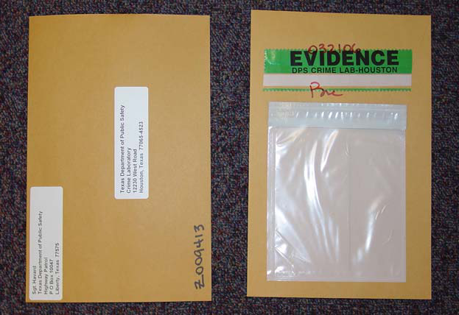
Proper Seal

Slide 37
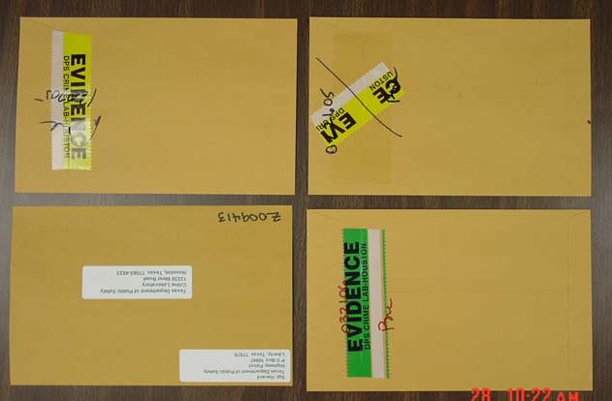
Proper Seal

Slide 38
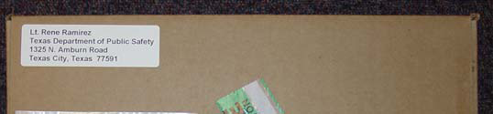
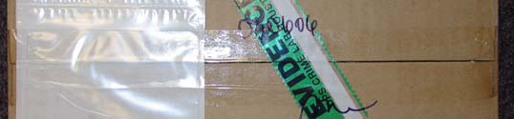

Proper Seal

Slide 39




Proper Seal

Slide 40
Storage Facility
Access
  controlled
  limited
  A list of authorized personnel should be maintained.
  Tracked
    Electronic (ex. card-key access)
    Written

Slide 41
Storage Facility
Environment
  Facility should be climate controlled to prevent deleterious change to the evidence.
    Maintain low humidity and room temperature (75°F) environment
    Protect from water damage, direct sunlight, and excessive heat
    Protect from rodent and insect activity

Slide 42
Storage Facility
“Why is the environment so important?”
    Rodents and insects like to eat the evidence
    DNA can be degraded by (among others):
      UV light
      Sunlight
      Heat
      Humidity
      Bacteria, microorganisms

Slide 43
Storage Facility
Climate controlled + pest free =
BEST environment
For counties with less than 100,000 individuals, DPS will store the evidence

Slide 44
DPS Storage
The following information must be included:
  Full name of convicted person
  Offense date
  County of offense
  Offense
  Sentence received
  Victim’s name
  Investigating agency and case number
  Inventory list of biological evidence

Slide 45
DPS Storage-Delivery
Items must be packaged to avoid contamination
Each item must be in a separate sealed paper package
Each package must be labeled for identification
Multiple packages related to a single offense may be placed into 1 outer container
May be delivered by mail, in person, or private carrier
The items must include a packing slip containing the cataloging information

Slide 46
Storage Facility
      Bad ideas:
        Basement level in a flood plane
        Garages
        Attics
        Sheds

Slide 47
Disposition of Evidence Retained by DPS
DPS must be notified by the submitting agency, prosecutor’s office or clerk’s office within 30 days of the inmate either completing their sentence or is released on parole or mandatory supervision or dies.
Upon receiving this notification, DPS shall return the evidence to the submitting agency, prosecutor’s office, or clerk’s office

Slide 48
Chain-of-Custody and Inventory Management

Slide 49
Chain-of-Custody
Definition:
  “the unbroken trail of accountability that ensures the physical security of samples, data, and records in a criminal investigation” - dictionary.com
  “A list of all persons who came into possession of an item of evidence.” - Richard Saferstein, Criminalistics: An Introduction to Forensic Science, 7th ed

Slide 50
Chain-of-Custody
  A log of evidence custody must be maintained in a written and/or electronic format.
  Each item of evidence should have a unique identifier that links it to a unique case number.
      Should already exist

Slide 51
Chain-of-Custody
  Documentation of the case information should be maintained including (but not limited to):
    victim’s and defendant’s names
    offense
    date of offense
    county of offense
    agency case #
    cause #
    lab case #

Slide 52
Chain-of-Custody
  Recommend the use of an electronic inventory management system that utilizes barcode tracking of individual items associated with a particular case

Slide 53
Chain-of-Custody
  Chain-of-Custody existed before computers
    Written documentation is perfectly acceptable
    For Instance…
    Evidence labels
    Date/Initials on the packaging
    Forms

Slide 54
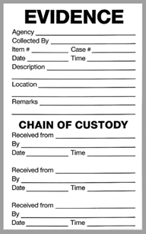
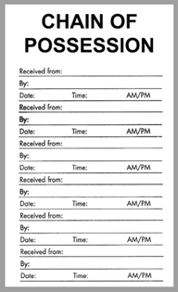
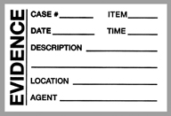
Chain-of-Custody
1000 pack = $80,
8¢ ea.
100 pack = $10, 10¢ ea.
100 pack = $10, 10¢ ea.

Slide 55
Inventory Management
  Microsoft Excel is a database program
  Part of Microsoft Office
  If you upgrade to a commercial system data in a spreadsheet program can be imported into the new system

Slide 56
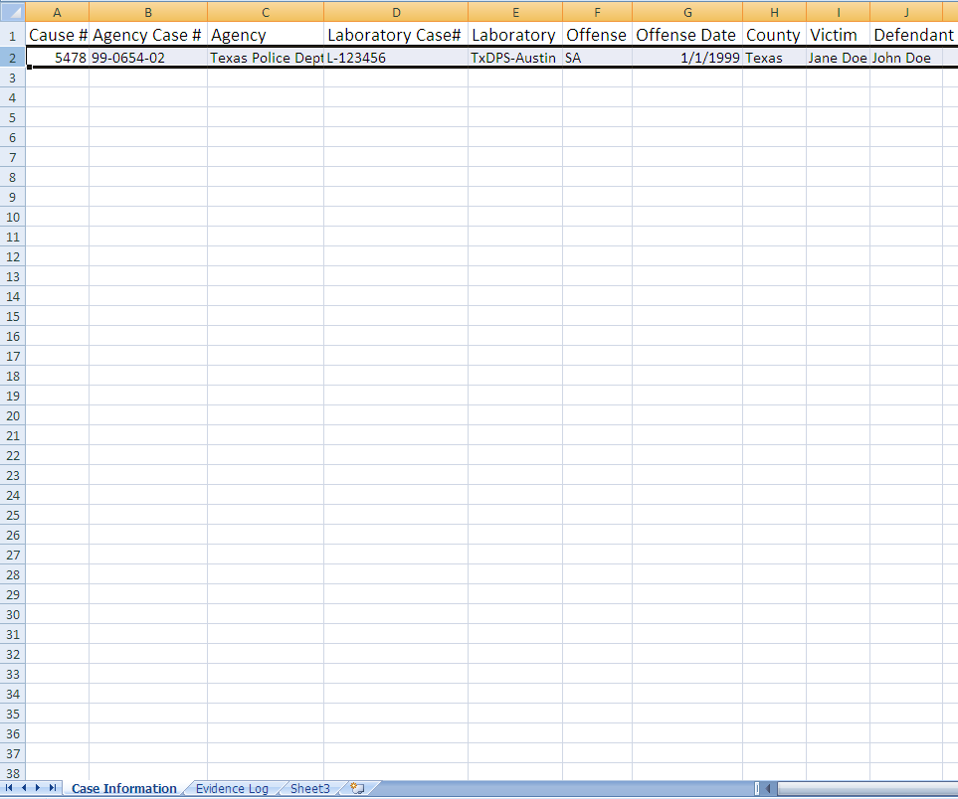

Slide 57


Slide 58
Biological Evidence Retention and Preservation Timeline
Applies to both adult offenders of felony offenses and to juvenile offenders of conduct constituting a felony.
Unsolved: not less than 40 years or until the applicable statute of limitations has expired OR if there is an un-apprehended actor associated with the offense

Slide 59
Biological Evidence Retention and Preservation Timeline
Convictions: If the defendant has been convicted, placed on deferred adjudication community supervision, or adjudicated as having engaged in delinquent conduct AND there are no un-apprehended actors associated with the offense:
  Until inmate is executed, dies, or is released on parole, if the defendant is convicted of a capital felony
  Until the defendant dies, completes their sentence, or is released on parole or mandated supervision, if the defendant is sentenced to a term of confinement or imprisonment in the TDCJ system

Slide 60
Destruction of Biological Evidence
The attorney representing the state, clerk, or other officer in possession of biological evidence may destroy the evidence but only IF the defendant, the last attorney of record for the defendant, and the convicting court are notified by mail AND a written objection is not received by the attorney, clerk, or officer from the defendant, attorney of record, or court before the 91st day after the later of the following dates
  The date on which the state’s attorney, clerk or other officer receives proof that the defendant received notice of the planned destruction OR
  The date on which notice of planned destruction of evidence is mailed to the last attorney of record for the defendant.

Slide 61
Summary
Biological Evidence Retention
Protect the Evidence = Protect Yourself
Separation of Evidence
Labeling and Packaging
Proper Storage
Chain-of-Custody and Inventory Management

Slide 62
A few other points…
If the items have already been examined by the crime laboratory
  Biological evidence has been as been retained by the lab, but future testing may need to re-examine the original item
    i.e. the defense wants their expert to choose different bloodstains

Slide 63
A few other points…
If you are unsure about
  How to package
  Whether or not you have to retain
  Or aren’t sure about an item…
  …Call the laboratory.

Slide 64
A few other points…
Mystery items you may have on your shelves…
  …unknown bottle of something???
  …call the lab. We will try to help.

Slide 65
QUESTIONS?
My Contact Information:
jody.koehler@dps.texas.gov
512-424-2997
Austin Laboratory Contact:
512-424-2105

