Slide 1
OCA’s Public Safety Report System
The PSRS System integration in local processes

Slide 2
Senate Bill 6
Enacted during the Second Called Session of the 87th Legislature (2021)
Related to procedures for:
Setting the amount of bail
Release of certain defendants on a monetary or personal bond
Duties of certain officers taking bail bonds
Duties of magistrates in criminal cases
Reporting information pertaining to bail bonds
Required:
The implementation of a statewide public safety report system (PSRS)
PSRS went live on April 1st, 2022
Produce a public safety report (PSR)
Create the Bail Form
Magistrates to consider the PSR for defendants charged with a Class B misdemeanor or higher offense

Slide 3
How do I access the PSRS?
Identify a Local Administrative User for your agency and complete the registration form
The LAU will receive instructions for accessing the system
The LAU can set up the other users
Step by step instruction is found in the “Help Center” or by contacting the Bail Inbox: bail@txcourts.gov
Determine what level of access each user will need and if they will be viewing or querying criminal history information.
If only viewing CHRI TLETS Criminal Justice Practitioner + CJIS
If querying CHRI TLETS Mobile Access + CJIS
All Judicial officers who perform magistrations are required to complete 8-hours of judicial education
Refer to your appropriate judicial training center for further information

Slide 4
Using the Public Safety Report System

Slide 5
Overview
Person is arrested
Person is processed
Defendant information entered in PSRS
PSR is produced
PSR presented to magistrate
Bail decision entered in PSRS
Certification of information
Art. 15.17 Hearing
Bail form is produced
Bail form is published by OCA

Slide 6
Recent enhancements
OCA has worked with AutoMon since implementation on various system enhancements……
Magistration Complete Date/Time column added
Ability to specify bail type & amount for each offense
New forms
Bond Modification
Bail form displays defendant date of birth
Bond conditions displayed based on offenses
Home page tab update
Video tutorials
Magistration data reports available in CSV file
Additional performance reports
OCA Global Admins can reset MFA and edit users email
Pending Bail Forms tab shows Entered by and Entered On Date/Time
Military Time format
API available
Notes:
API is Application Programming Interface-allows your case management system to send information to the PSRS so that you are not having to duplicate the same data in multiple systems.

Slide 7
Application Programming Interface
The API allows case management systems to communicate with the PSRS
Reduces inputting the same data into multiple systems
Adding an arrest via the API - from the Case Management System (CMS) to PSRS
Defendant First and last name
Defendant DOB
Arrest date and time
County of arrest
Offense(s)
Magistration location
Notes:
What is API you ask? Application Programming Interface. This will allow your case management system to communicate with the PSRS and will reduce inputting the same information in multiple systems.

Slide 8
API Is Currently Available For Use
Courts with vendor hosted systems should talk to their vendor
Vendors that have been contacted:
Central Square Technologies
Tyler Technologies
Hill County Software
Edoc Techologies
TechShare
Tiberon
NetData
Southern Software
Courts that maintain their own system should reach out to OCA at: bail@txcourts.gov
Notes:
The API is currently available for use. If you have a vendor, check with them to see where they are in the process. If your vendor is not listed and you are interested, tell them to contact AutoMon for next steps. If you have your own system, contact OCA and we will get you to the right people to start the process.

Slide 9
Upcoming Enhancements
Check box for juvenile offenders who are certified as adults
Ability to indicate individual cause/case numbers for each offense
Removal of DOB calendar
Ability to indicate if an offense is an enhancement or mitigation, ie: “Attempted”, etc.
Allow LAUs to select discretionary bond conditions through the Location Configuration tab
Notes:
If you have any ideas for enhancements that would make the system better for everyone, drop us an email at bail@txcourts.gov.

Slide 10
System demonstration

Slide 11
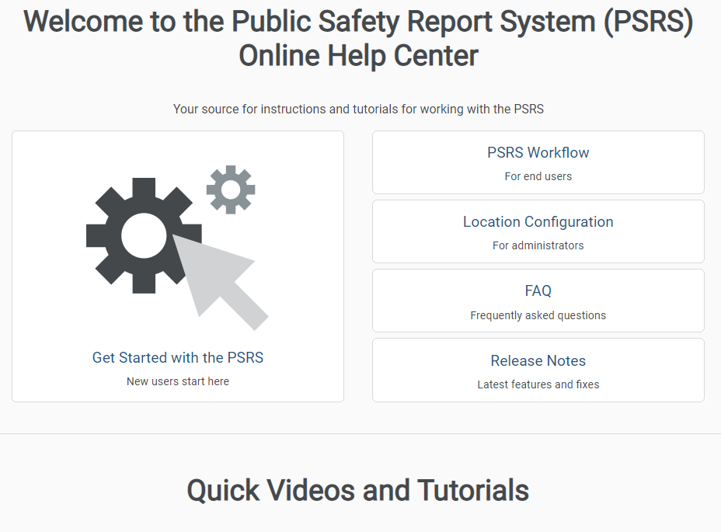
HELP CENTER The PSRS Help Center offers step by step instruction and videos.

Slide 12
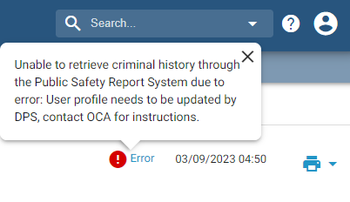
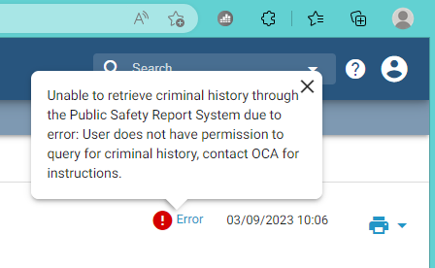
Common DPS Errors
FORMAT ERROR – MINIMUM 3 OPTIONAL FIELD(S) OF SET (SEX) (RAC) (DOB)
– submitted too few fields
DATA ERROR
NAM (contains prohibited apostrophe)
SID (missing state identifier)
FBI (blank field, contains SID, contains invalid data)
USER REJECTS
Not authorized to send request (CJP users)
No matching profile
TLETS certification date expired
Invalid ORI
Invalid user ID

Slide 13
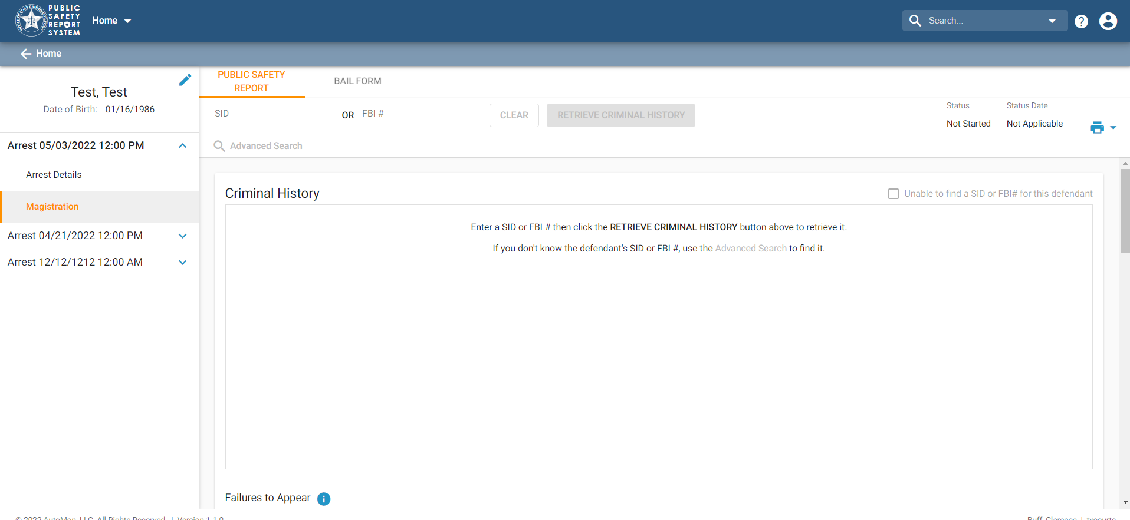
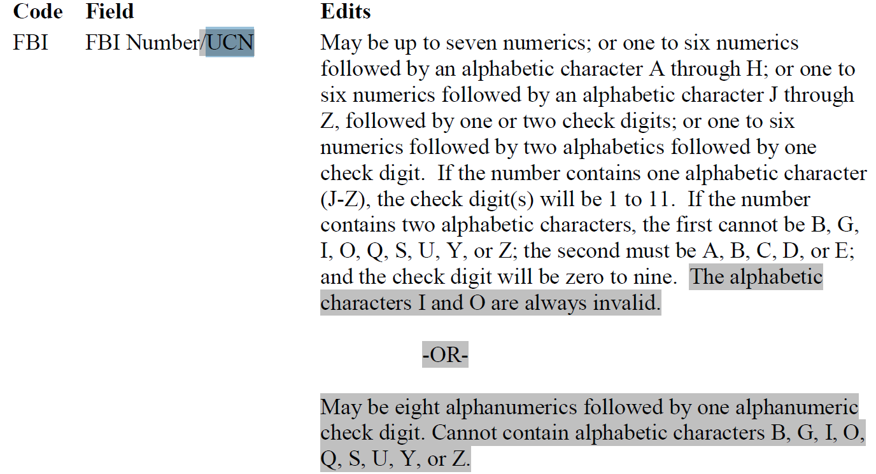
SID and FBI Numbers
SID Number
When entering a SID number, you must enter “TX” before the number

Slide 14
Bond Modifications
On the existing Bail Form, click the edit icon on the upper right side. A dialog box opens.
Select Bond/Condition Modification for Edit Reason. Click Continue.
A new bail form tab opens. Select the current Magistration Location, Date and Time.
4. Make changes as needed. Certify and complete Bail Form.
Notes:
If the defendant's bond is modified after certifying the Bail Form, you can complete and certify a new Bail Form to document the changes. The PSRS maintains both the original and modified Bail Forms on separate tabs for review.
You would also use the edit icon to correct an error after the bail form is completed. Remember that when you click on the icon, you have removed the certification and will have to re-certify the form after making your corrections.

Slide 15
Juveniles & the psrs
Juveniles should not be processed through the PSRS unless they have already been certified as adults.
When entering a new arrest, do not use the calendar feature to enter the DOB, instead use the MM/DD/YYYY format.

Slide 16
FREQUENTLY ASKED QUESTIONS
Help I’m locked out!
The system will automatically reset in 5-10 minutes. If it still will not work, email bail@txcourts.gov
I got a new phone and need to reset my multifactor authentication.
Email bail@txcourts.gov
What do we do with out of county warrants?
Same as in county charges. Use the name and location where the magistration is completed.
What about out of State warrants?
Out of state warrants will not be processed through the PSRS.

Slide 17
FREQUENTLY ASKED QUESTIONS
What do I do if I can’t find the offense I’m looking for in the PSRS?
Try searching by offense code. Sometimes offense names or the offense code changes. Search the Penal Code to verify offense title.
Can you delete a user? We entered the wrong email.
We are unable to delete a user, but we can correct an email if you will contact bail@txcourts.gov
What do you use for arrest date when the defendant is already in jail and another warrant comes in?
Use the date the new warrant is served.
I am getting an error when I try to enter a SID and query the offender’s criminal history-what is going on?
There could be several reasons: #1 you only have Criminal Justice Practitioner certification; #2 the grace period to take the Mobile Access course has expired; #3 your certification has expired; or #4 you already had TLETs certification and DPS needs to give you access to the PSRS

Slide 18
What other Questions do you have?
Contact us at: bail@txcourts.gov

