Slide 1
Laboratory evidence handling & forensic biology screening
Chief Brady Mills
&
Erika Avila
(Former DNA Analyst)
Texas Department of Public Safety
Crime Laboratory

Slide 2
overview
Biology/DNA Case Acceptance Policy
Evidence Handling Practices
Forensic Serology Screening

Slide 3
Case acceptance policy
Biology/DNA Analysis – Customer Handbook
For all case submissions, the number of items or samples that are tested is limited to the minimum number necessary to answer the relevant questions in the case.
The Laboratory does not accept and/or perform DNA testing on:
  Paternity cases
  Any evidence from seized drug offenses
  Items submitted in possession offense cases involving firearms
Touch* DNA is DNA from items which are suspected to not have biological fluids, but are collected in an effort to obtain DNA from skin cells.
  Requests for touch DNA analysis on items recovered from property crimes will not generally be accepted by the laboratory.
  Requests for touch DNA analysis on items recovered from violent crimes may be accepted on a case-by-case basis. Consultation with the laboratory prior to submission is recommended.
  In general, the Laboratory does not analyze items where there has been a minimal amount of contact involved (e.g. contact with steering wheels, shift knobs, door handles, switches, countertops, keys, locks, ammunition, cartridge cases, friction ridge impressions, etc.).

Slide 4
Case acceptance policy
Biology/DNA Analysis – Customer Handbook
Hair evidence submitted for DNA analysis is examined in consultation with a Trace Evidence analyst prior to DNA processing.
In general, the Laboratory does not perform Biology/DNA analysis on fecal/stool samples or vomit samples.
Negative sexual assault kit with preserved trace evidence is forwarded to the Trace Evidence Section for analysis.
Suspect known reference samples submitted are not processed for entry into CODIS IF:
  They were submitted without associated evidence
  Screening results have been released and no evidentiary samples will be analyzed for DNA; or
  DNA analysis results have been released and no further comparisons are necessary.
The type and number of items or samples that are accepted for analysis is based on the type of offense
  Known/reference samples do not count against the number of items that may be submitted

Slide 5
Case acceptance policy
Number of items accepted based on type of offense
Burglary or Property Crime Related Offenses
  Submission is limited to 2 items
  More than 2 items may be accepted if the circumstances dictate the need for additional analysis (such as multiple perpetrators)
Sexual Assault Related Offenses
  Initial submission is limited to the sexual assault kit, 1 pair of underwear, & a condom
  Up to 2 additional items which have been determined by the customer to be most probative may also be submitted after prior consultation & approval by laboratory.
  If analysis of the sexual assault evidence collection kit is negative, a second submission of up to 5 items, such as clothing or bedding, may be accepted.
  If no sexual assault evidence collection kit was collected, submission of items such as clothing, bedding, or requests for Touch DNA analysis may be accepted during the first submission. Consultation with the Laboratory prior to submission is recommended.

Slide 6
Case acceptance policy
Number of items accepted based on type of offense
Homicide Related Offenses
  Initial submission = 10 items for which the customer believes analysis will be most informative
  If no informative results are obtained from the analysis in the first submission, a second submission of 10 additional items may be accepted
  A written request from the Prosecutor, including sufficient justification, must be received by the Laboratory before any decisions on performing additional testing are considered once informative results have been obtained.
  Additional samples are not tested to merely disprove all possible scenarios
Crimes Against Persons Related Offenses
  Submission is limited to 5 items
  The type of evidence, how the evidence may have been used/handled, and the duration of the use/handling is considered when determining if the evidence will be processed for DNA analysis.

Slide 7

Life after submission
What happens once evidence enters the lab?
Goal
To prevent evidence
loss, damage, and contamination while maintaining a proper chain of custody
Evidence gets accepted by the evidence receiving team
Evidence gets stored in a location with limited access
Analyst takes possession of the evidence
Analyst performs serology screening on evidence
Evidence gets returned

Slide 8

Evidence handling
Best practices
During submission
  Evidence receiving (ER) team ensures packaging is intact, proper seal, & storage requirements based on evidence type
During screening
  Proper PPE
  Only 1 item of evidence open at a time
  Clean lab bench & tools between items
  Ensure proper storage conditions

Slide 9
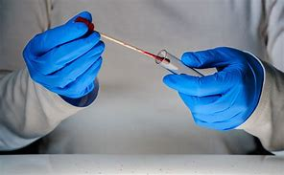
Serology screening
Analytical Approaches to Body Fluid Identification
Blood Examinations
  Visual examination
  Preserve trace evidence when appropriate
  Presumptive testing
  Preserve the stain, cutting or swab
  Test for other body fluids if indicated
Semen Examinations
  Visual examination
  Preserve trace evidence when appropriate
  Alternate Light Source (ALS) tool
  Presumptive testing
  Confirmatory testing
  Preserve the stain, cutting or swab
  Male screening can be used as an alternative

Slide 10
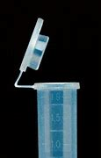

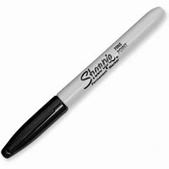
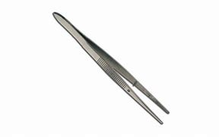
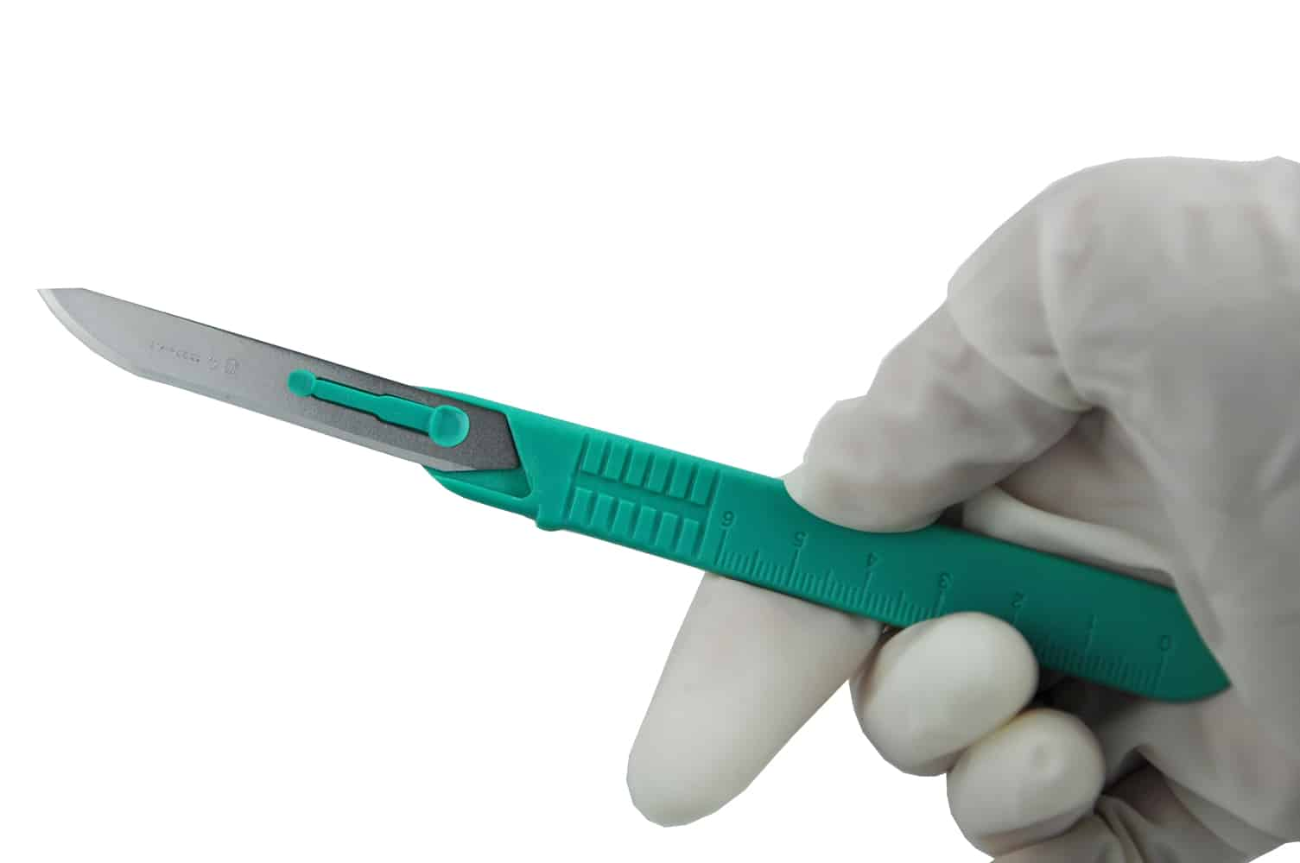
Serology Screening
Can an analyst stop screening?
How far the analyst proceeds in a particular case will depend on the available sample and on what is necessary to answer the question(s) posed
Example: once semen is confirmed on at least 1 item it is not necessary to examine other items unless circumstances dictate the need for additional analysis (e.g. multiple assailants and/or consensual sex partner(s))
Tools used in Serology:
Male screening
Alternate Light Source (ALS)
Scalpel blades, tweezers, sharpies, envelopes,
tape, sterile tubes, swabs, bench paper

Slide 11
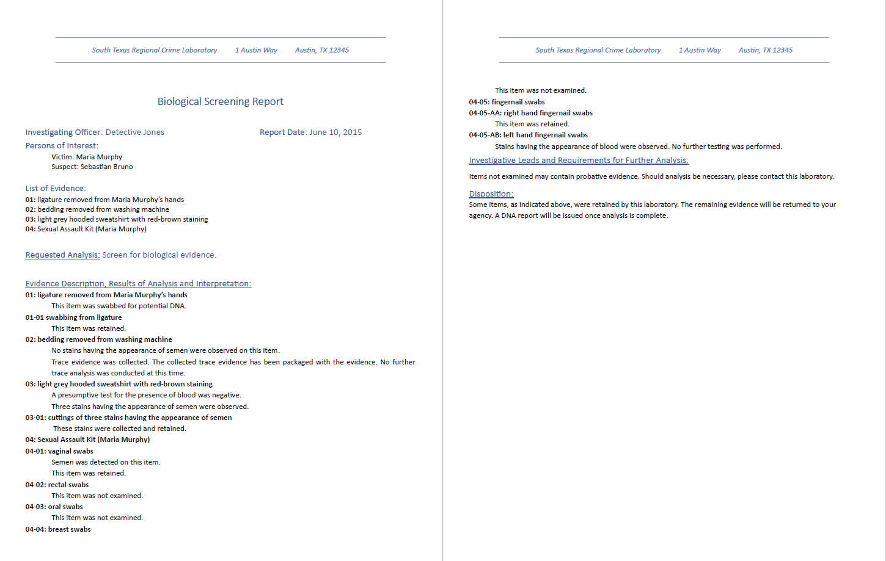
Biology Laboratory Report

Slide 12
Impact of evidence collection & handling irregularities
Collection/handling of evidence (prior to submission)
  Contamination
    No gloves/mask
    Packaging evidence together (cross-contamination)
  Degradation
    Packaging evidence in non-breathable containers
    Not allowing wet items to fully airdry
    Improper storage
  Evidence loss/switch
    Labeling packaging
Handling of evidence within the laboratory
  Contamination
  Degradation
  Sample switching

Slide 13
Recommendation from the
TeXas Forensic Science commission
TX DPS Records Program has developed minimum requirements for a typical litigation packet in order to ensure that all customers are receiving consistent information.
The litigation packet is sent upon receipt of a subpoena
In the works → records portal (Tex. Gov't. Code § 411.162)

