Slide 1
Understanding DNA Extraction, Quantitation and Amplification
Cassandra Canela
Ariel Payan

Slide 2

Overview
Overall analytical process
  Basics
  Differential extraction vs unknown/known extraction
  How to find the information within paperwork
Issues
  Contamination
  Sample Switches
  Inhibition/Degradation
  Prevention and Detection – quality assurance

Slide 3



Step 1: Extraction
Removal and isolation of the DNA from the sample collected at serology.

Slide 4
How do we extract the sample:
Two main steps
  Lysis
    Heat and multiple chemicals are used to break open the cells in the bodily fluid and release the DNA.
  Purification
    Unwanted cell parts are removed, and the pure DNA is suspended in liquid.

Slide 5
Two categories of Extraction
Differential Extraction
Allows for isolation of sperm cells – samples suspected (or confirmed) to contain semen
  Sperm cells outer membrane requires a stronger chemical than other cell types
  Vaginal swabs
  Breast swabs
Unknowns and Knowns (Non Differentials)
Isolates all DNA from all DNA sources (i.e. semen, blood, skin cells, etc)
  Unknowns
    Right hand fingernail swabs
    Swabbing from ligature
    Cutting … from light grey hooded sweatshirt
  Knowns
    Blood card
    Buccal swab

Slide 6
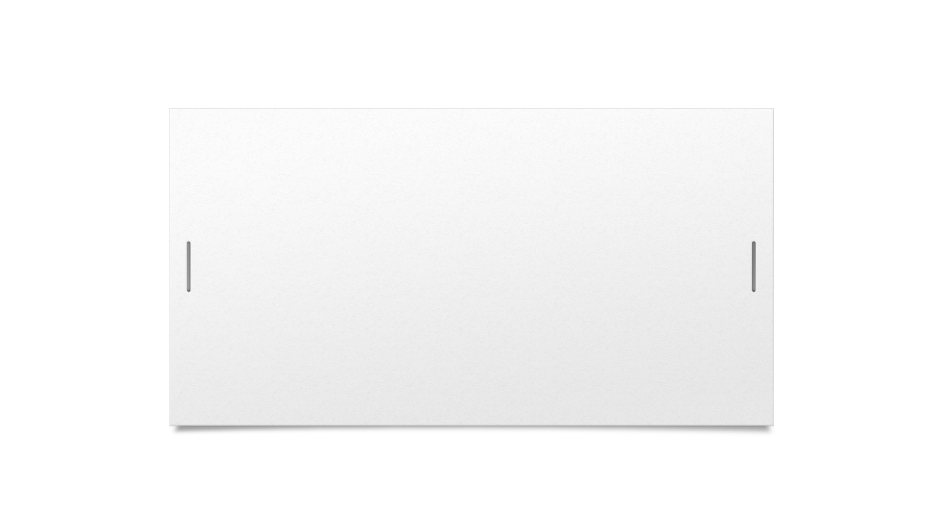
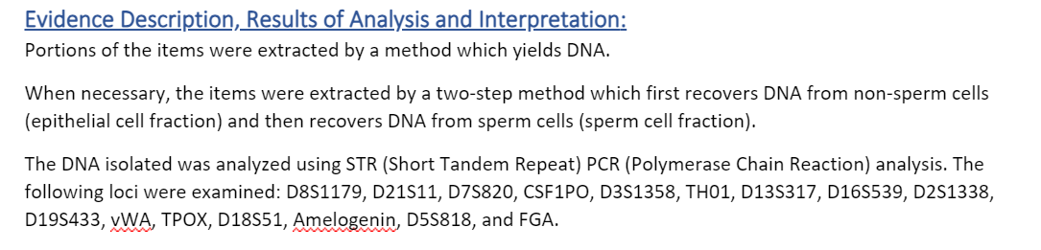
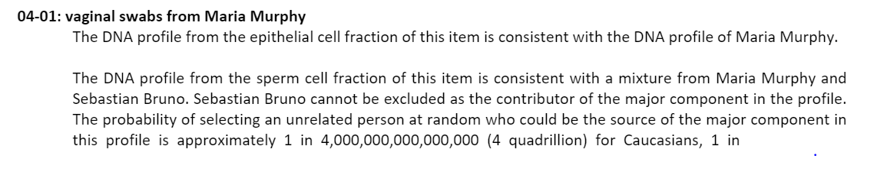

How do you know which category of extraction was performed on your sample?

Slide 7
Lysis: Differentials vs. Unknowns/Knowns
Differentials
Unknowns/Knowns
Combination of chemical(s) added at the same time to break open all cells that may be present
Chemical 1 (ex. pro K) added to sample
Liquid containing DNA from cellular material removed leaving liquid containing intact sperm cells (removed portion - epithelial cell fraction)
Additional stronger chemical (ex. DTT) added to break open sperm cells and release the DNA (sperm cell fraction)

Slide 8
Potential Issues with Differential Extraction
Carry Over
  Fraction doesn’t separate 100%
Sperm cells - lost
  Pipette up sperm fraction with removal of epithelial fraction

Slide 9
Quality Assurance Measure:
Reagent Blanks
Consist of all reagents used in the procedure just without any actual DNA added
Must have at least one per extraction batch
Must be extracted alongside the samples
Main purpose – used to detect contamination

Slide 10
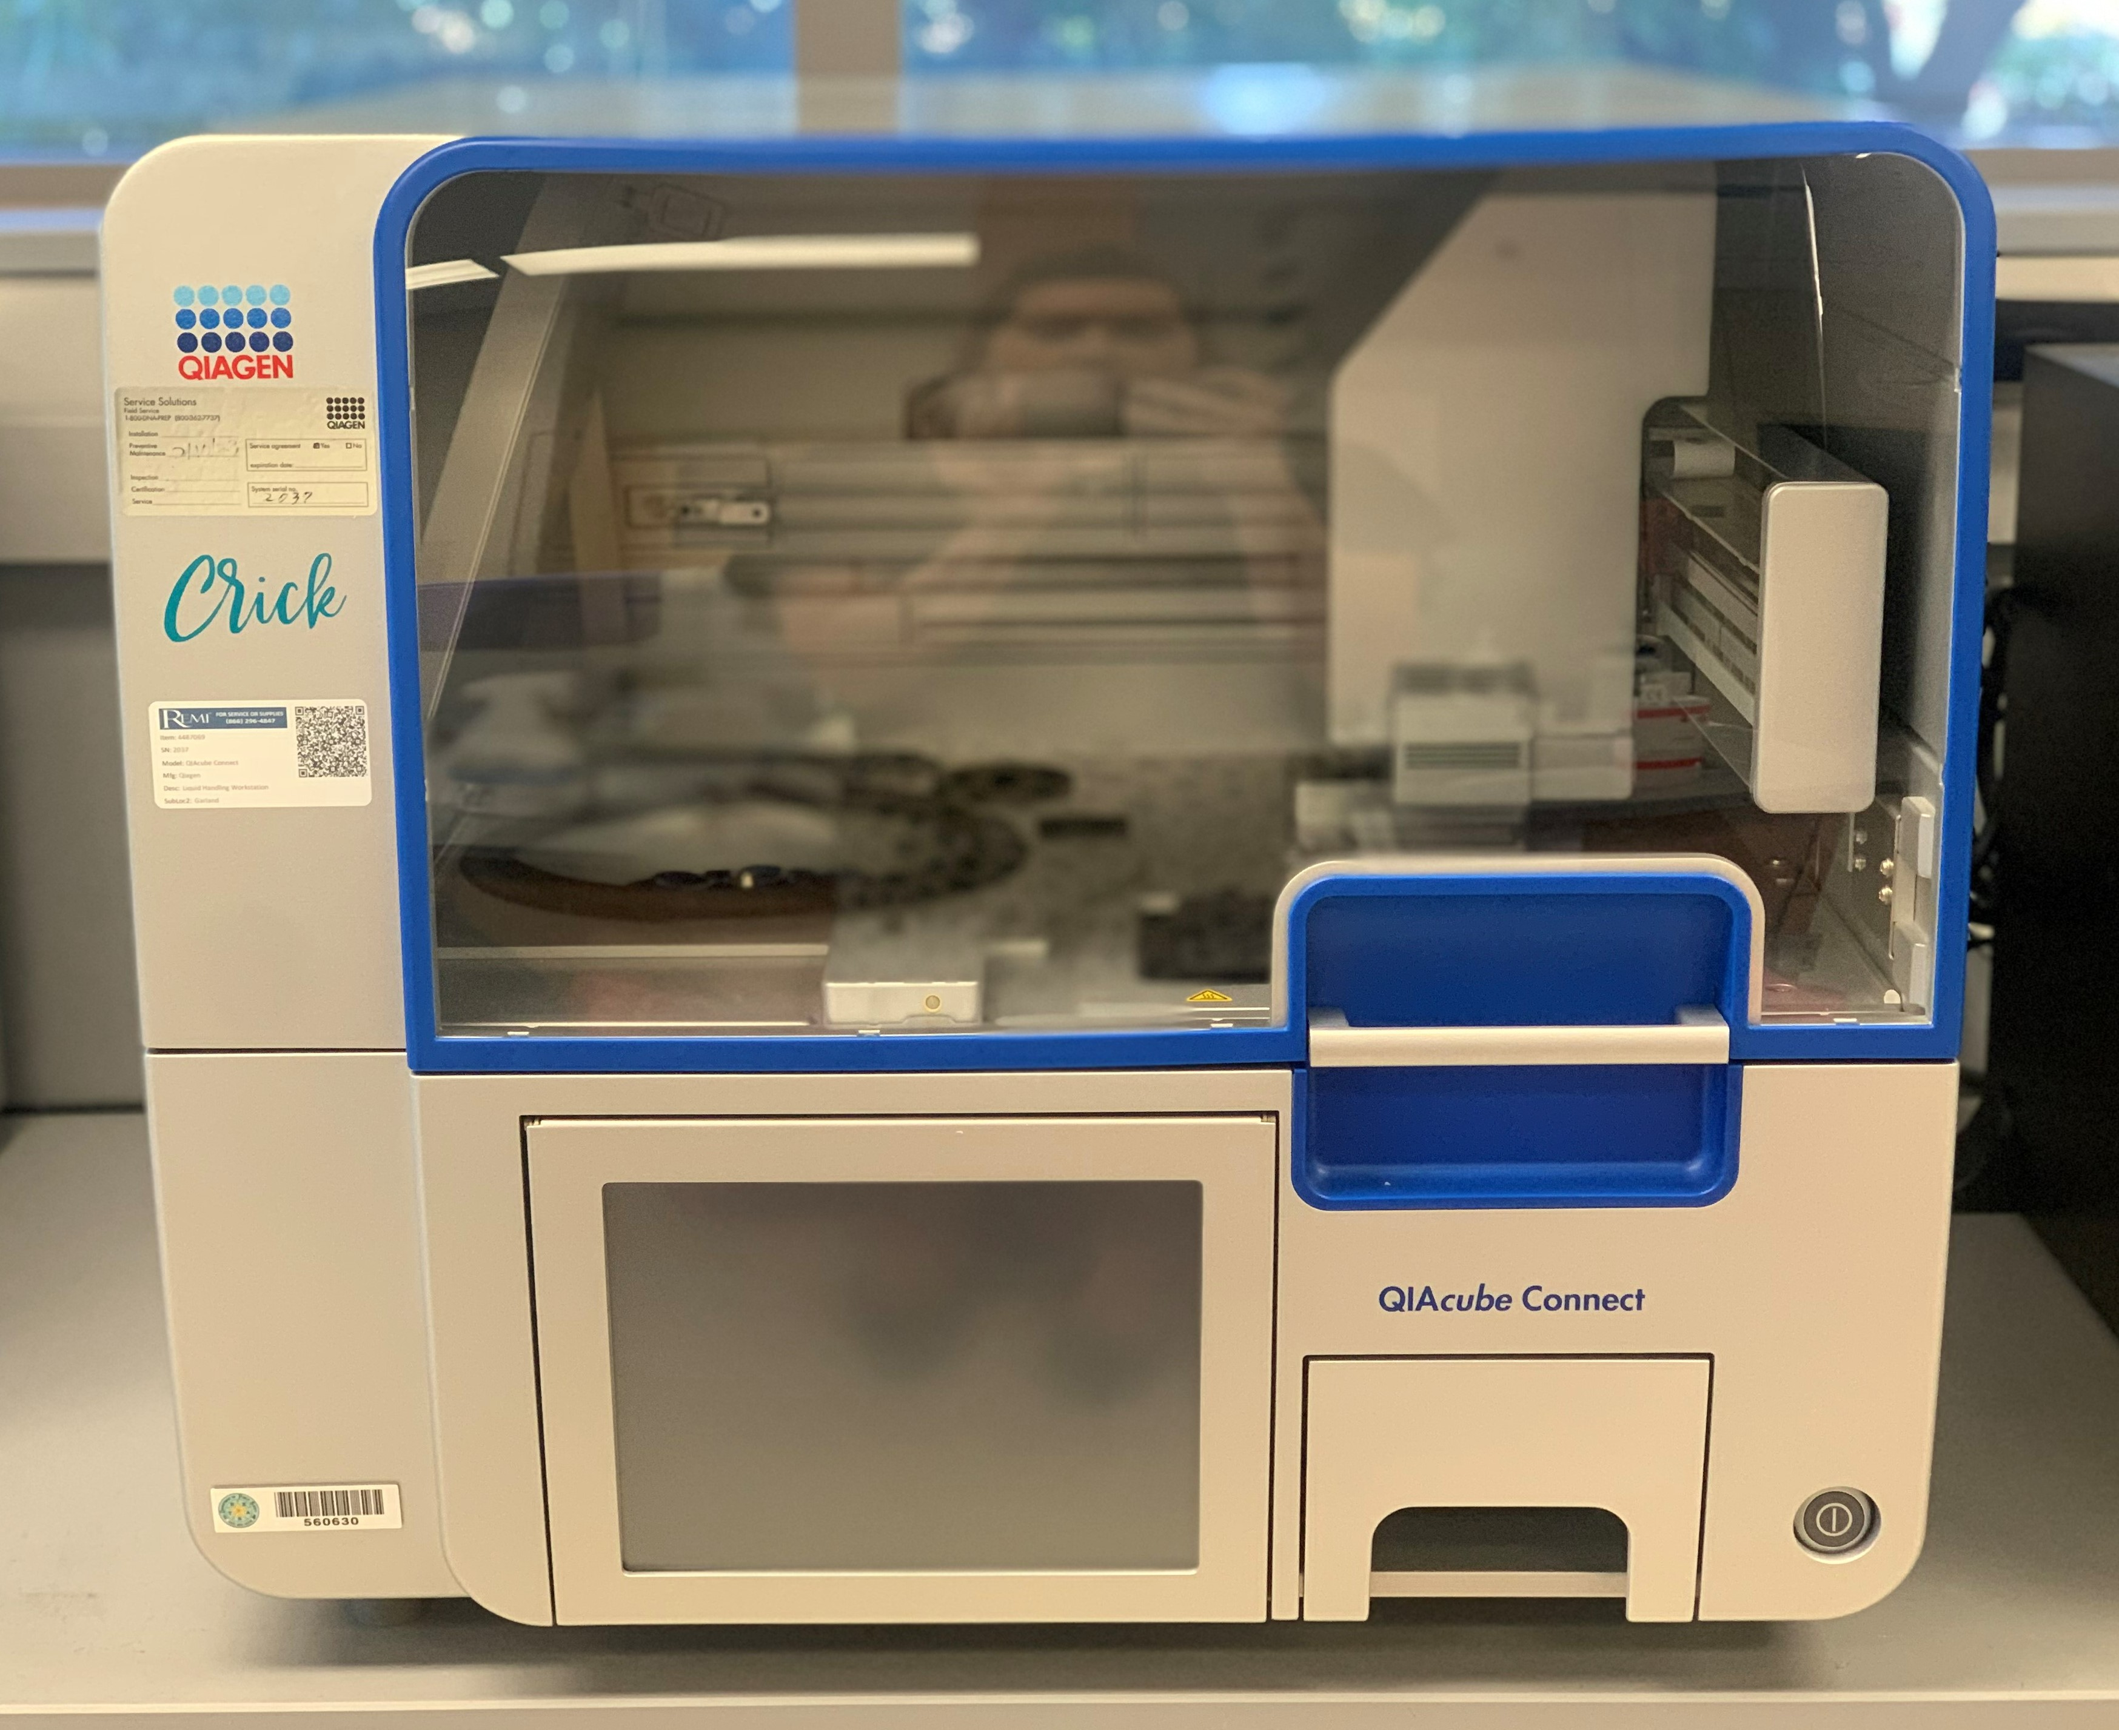
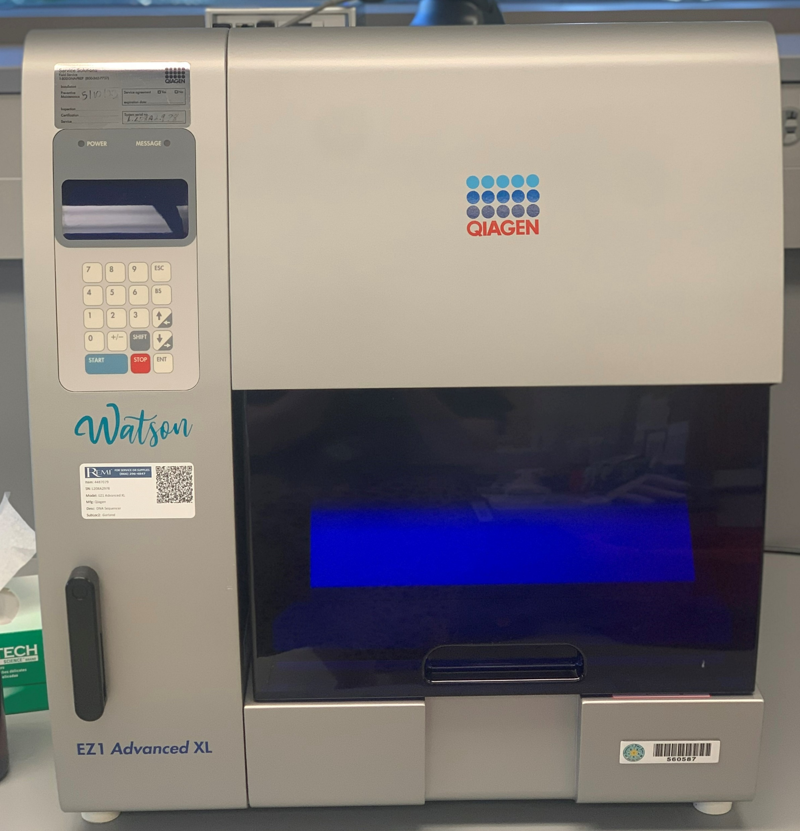
Manual vs Robotic Extraction
Manual
Robotic
More labor intensive on the analyst
Minimal equipment needed
One tube open at a time
Less human manipulation
Improves accuracy and precision between sample and from plate to plate
To set up instrument, all sample tubes will be open at the same time

Slide 11
Potential Issues: Contamination and Sample Switch
Can’t tell right now – could suspect if something happened during extraction (documentation?)
Contamination
  Detectable in reagent blanks
  Minimized by:
    use of robotics
    decontamination of workspace, equipment, and consumables prior to extracting
Sample Switch
  Robotics – correct placement of samples
  Be vigilant and reduce distractions

Slide 12
Step 2: Quantitation
Determine Approximately how much DNA Is present in the sample
  An estimation

Slide 13
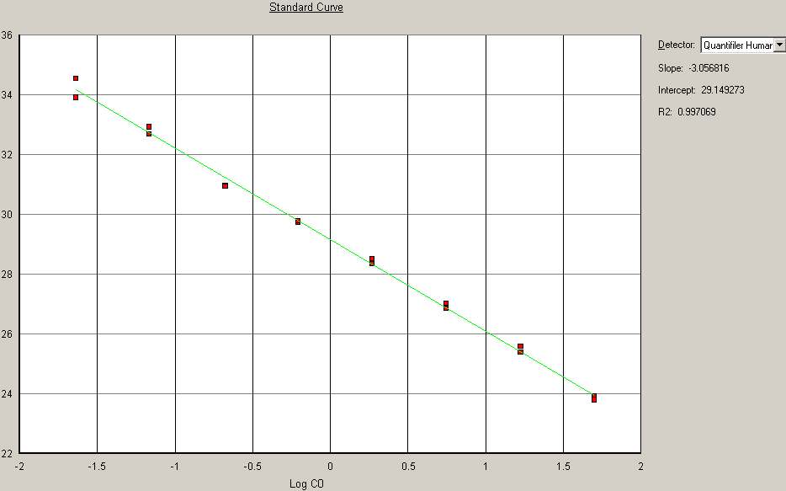
Basics: Real Time PCR
Utilizes a standard curve – set of samples with a known amount of DNA (range is dependent on kit used)
Instrument detects the fluorescence of the sample in “real time”
Time of fluorescence is compared to the standard curve and an approximate quant value is reported by the software

Slide 14
Quality Assurance: Controls
Standard Curve
  Must meet specific requirements
Negative Template Control
  Similar to reagent blanks
  Contains all reagents, no DNA
Background plate
  Can be run at certain intervals to help detect fluorescence that is present in the instrument itself
  Helps decontaminate/clean the instrument

Slide 15
Potential Issues: Contamination and Sample Switch
Contamination
  Possible Detection
    Should not have quant value in reagent blanks or negative template control
Sample Switch
  Detection – limited
    Reagent blanks
  Prevention
    Use of robotics
    Possibility of verification

Slide 16
Why do we Quant? – 3 reasons
Distinguish between inhibition and low template samples
1

Slide 17
Additional potential issue: Inhibition
What is it???
Caused by things contained within the sample itself that were not removed during extraction and can prevent (inhibit) the amplification process from happening
  Can prevent the process either partially or entirely
Detection
  Utilizes the IPC (internal positive control) within the quant reaction
  Information available within lab’s quant paperwork
Notes:
.

Slide 18
Why do we Quant? – 3 reasons
Distinguish between inhibition, degraded, and low template samples
1
Determine the optimal amount of our sample needed to perform the amplification process
2
Help us choose the “appropriate” DNA testing procedure to perform (quant thresholds)
3

Slide 19
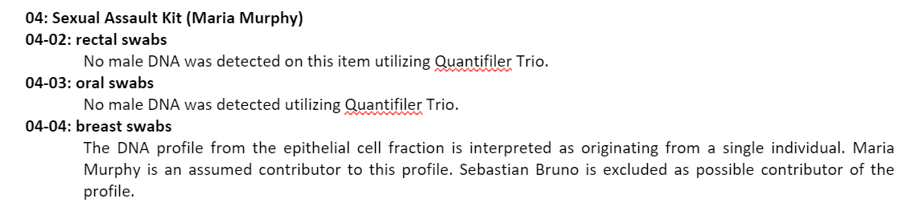
Quant Threshold

Slide 20
Step 3: Amplification
Making billions of copies of specific locations on the DNA that we want to look at
Utilizes the polymerase chain reaction (PCR)

Slide 21
What is being copied?
Short Tandem Repeats (STR)
Number of locations copied is kit dependent
  Current kits
    GlobalFiler
    Investigator 24plex
    PowerPlex Fusion
  Older kits
    Identifiler Plus
    PowerPlex 16
    MiniFiler
  Y-STRs
    PowerPlex Y23
    Yfiler Plus
    Investigator Argus Y-28

Slide 22
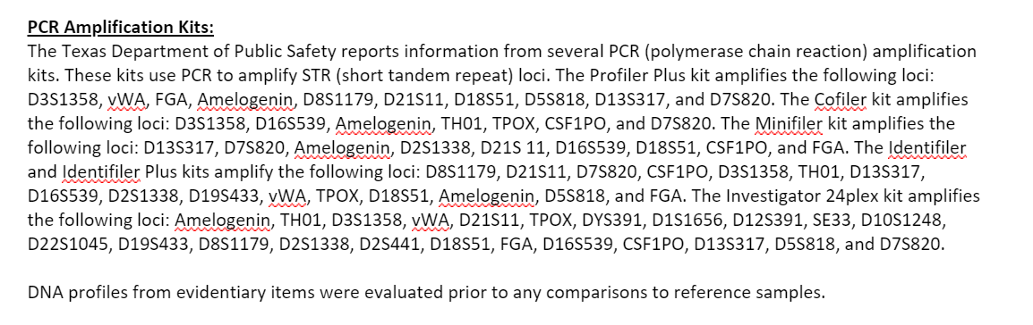
How do you know which kit was used?

Slide 23
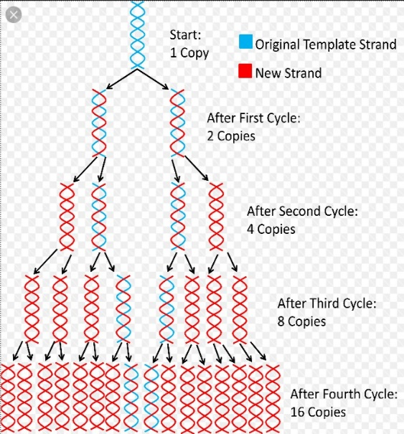
Basics: How does it work?
Polymerase chain reaction
Cyclic process
  1 cycle utilizes three separate temperatures to break apart the DNA, find the area we want to copy, and make the copy
  Cycle 2 – N: repeats these three temperatures

Slide 24
Optimal Amount of Sample Needed for Reaction
Each kit validated at a range of optimal DNA Template
Sweet spot wanted where we have an optimal amount of copies being made during the PCR process
  Too much – leads to an excessive amount of artifacts and difficulties in interpretation
    Reamp less
  Too little – leads to not enough copies being made which can lead to difficult interpretation
    Sample dependent
    Reamp more, if possible

Slide 25
Quality Assurance: Controls
Positive Control
  Known DNA from a known individual
  Will lead to a known DNA profile during separation/detection step
  Included in kit
Negative Control
  Similar to reagent blanks
  Contains all reagents, no DNA

Slide 26
Potential Issues: Contamination and Sample Switch
Like extraction - can’t tell right now; unless something happened during set up process that would indicate the possibility (documentation)
Contamination
  No DNA in negative control (or reagent blanks)
  Prevention
    use of robotics
    decontamination of workspace, equipment, and consumables prior to extracting
    Dedicated workspace for amplification set up
Sample Switch
  Prevention
    Robotics
    Possibility of verification

Slide 27
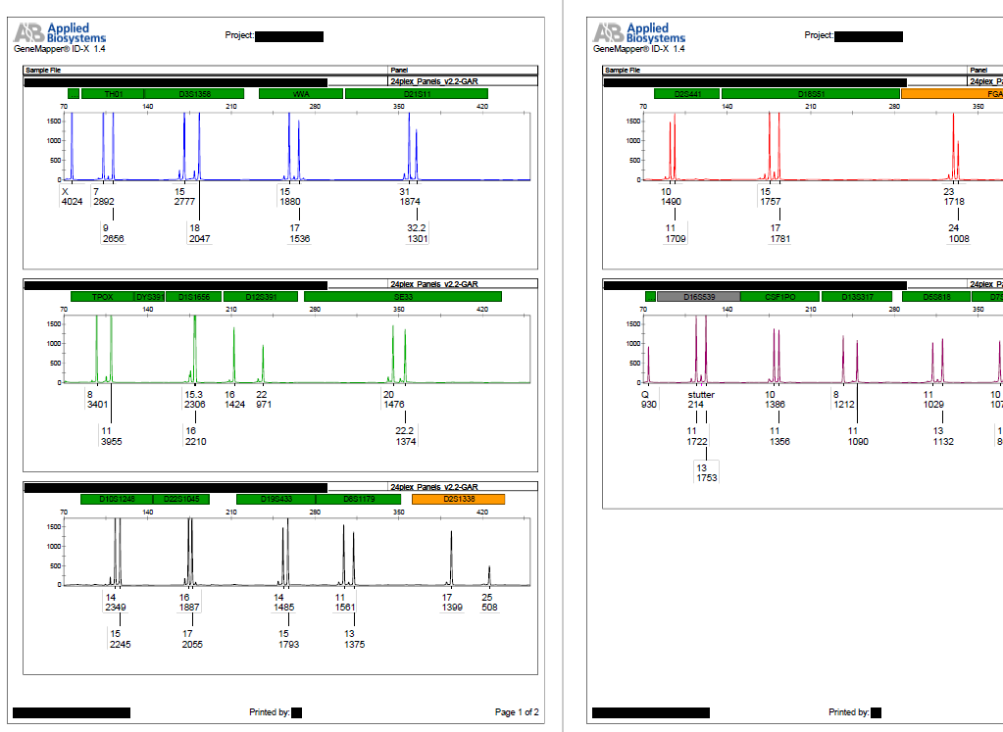
Final Step (4): Separation and Detection
Taking all the copies we made, separating them by size and detecting them utilizing a laser and a camera. The detection is captured in a picture/graphical format called an electropherogram (the DNA Profile).

Slide 28
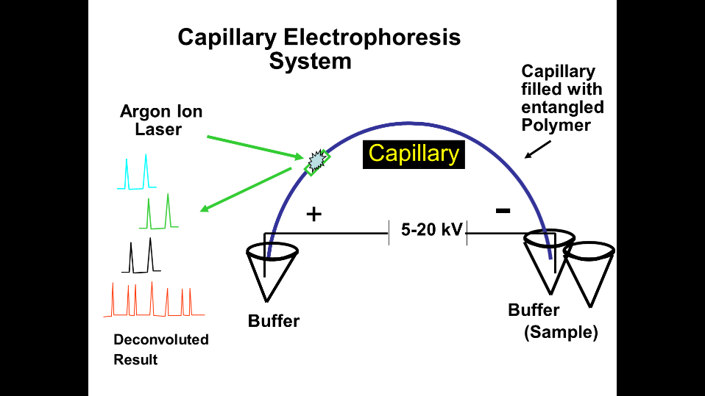
Basics: How it works
Since DNA is negatively charged, we use a process called capillary electrophoresis.
Notes:
This process works by using capillary electrophoresis. Since your DNA is negatively charged, it gets put at a negatively charged end of a skinny tube called a capillary. An electric current gets applied to the capillary. And similar to a magnet, the negatively charged end repels the negatively charged DNA through the capillary to the positively charged side. On the positively charged side, there is a laser with a camera in a detection window where the detection portion happens.

Slide 29

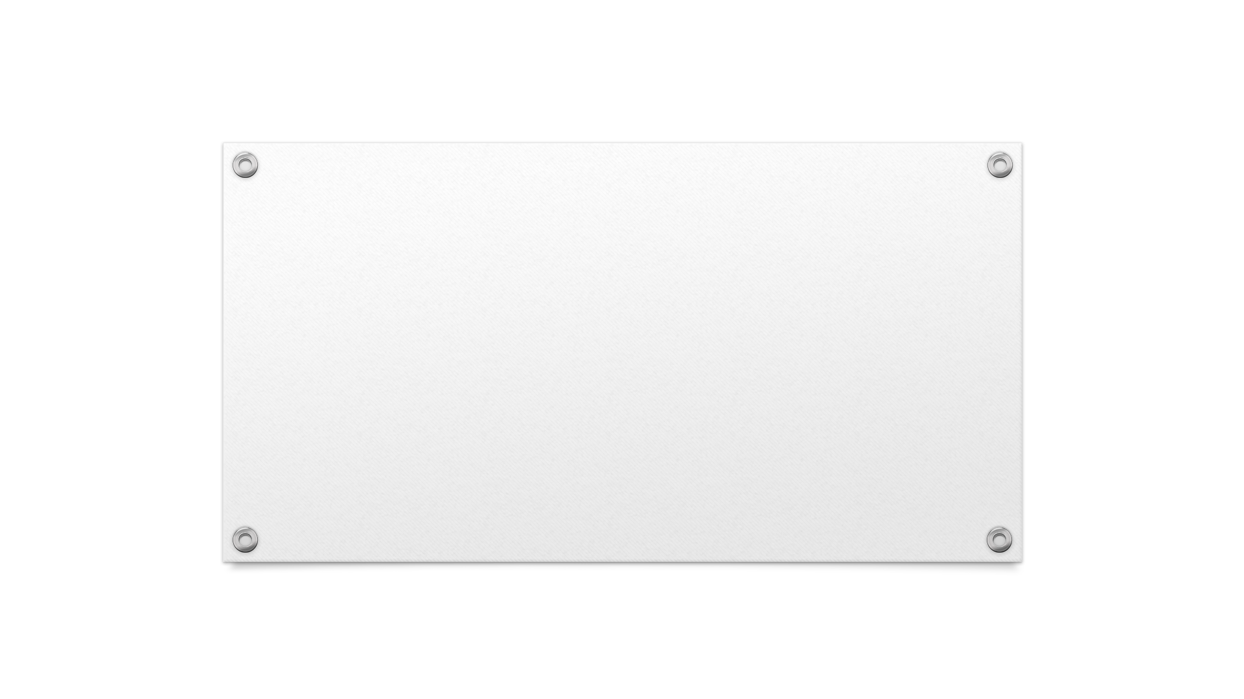
Now we can further assess both the quality controls and the potential issues that occur during the lab process.

Slide 30
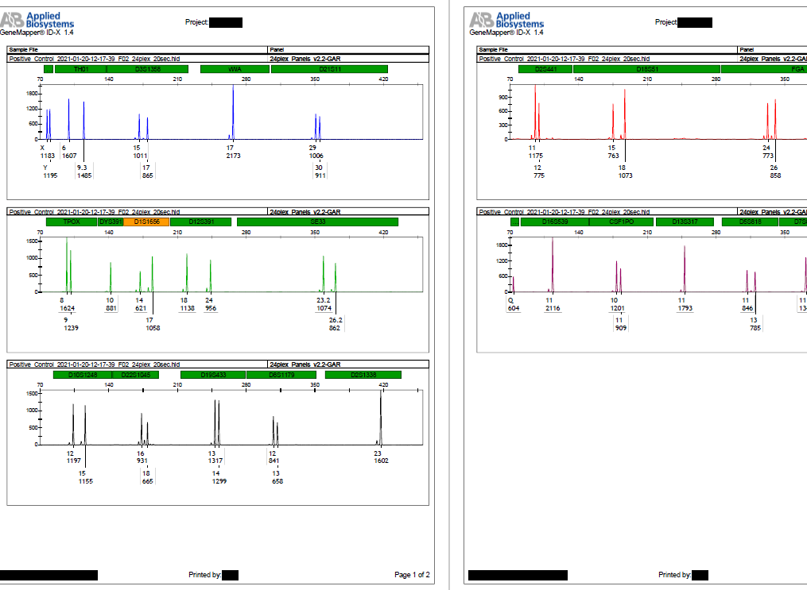
Did the amplification process work?
Amplification positive control
  The correct DNA profile MUST be detected

Slide 31
Contamination
Labs are required to have a procedure that covers the detection and prevention of contamination (per the quality assurance standards set by the FBI).
Definition of contamination will be lab/lab system specific.

Slide 32
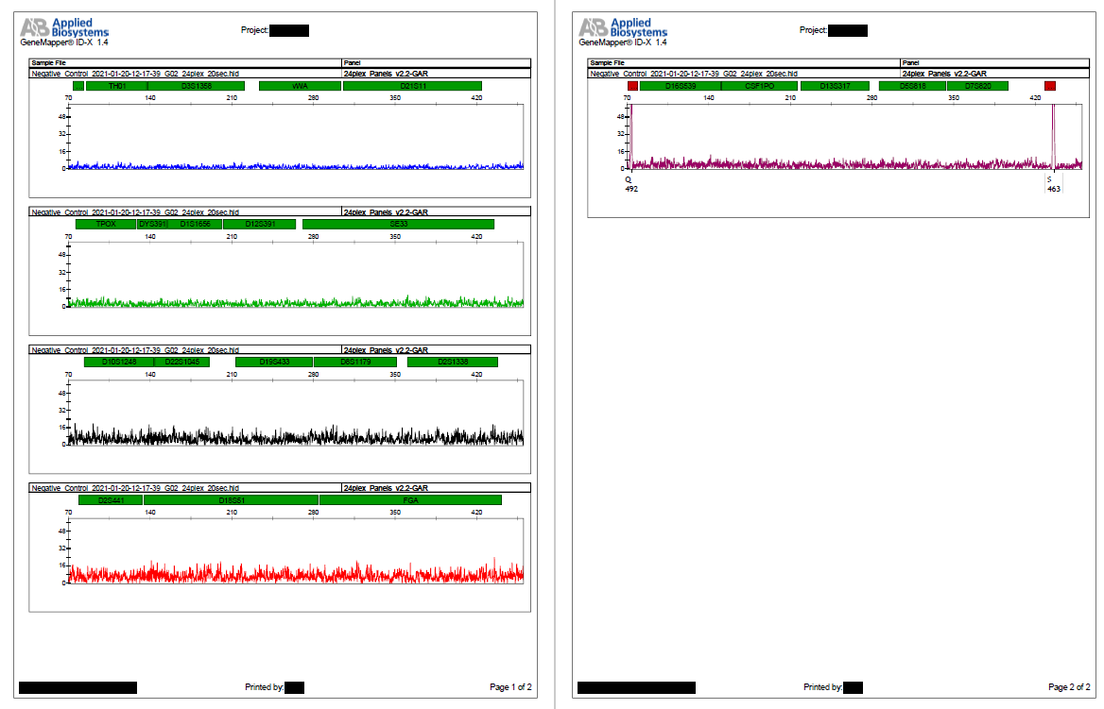
Reagent Blanks and Negative Amplification Controls
Assessed for Contamination
Want them to be free of contamination

Slide 33
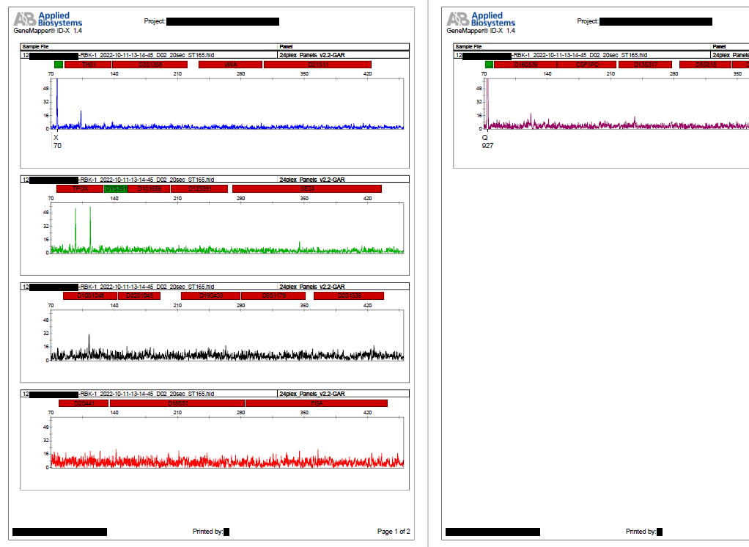
Contamination Detected
If contamination is detected, the lab will follow their contamination protocol.
The detection of contamination should be documented in the lab’s paperwork

Slide 34
Profile Comparison Tool
Detection for Contamination and Sample Switches
Component of Data Analysis Software
Compares samples within batch to other samples within batch and to lab personnel/lab contractors contained within the software

Slide 35
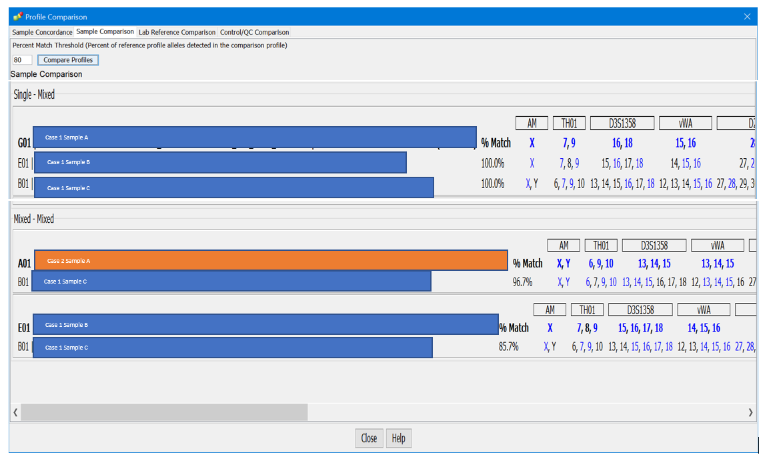
Profile Comparison Example

Slide 36
Inhibition
Inhibition –
  Profiles can simply look like low level samples.
  Can do additional steps to overcome inhibitors if sample is inhibited (remember quant info).

Slide 37
Additional Potential Issue: Degradation
What is it?
Caused by the DNA breaking down from one long strand into shorter broken strands (typically caused by environmental factors like humidity or sunlight). The shorter strands can prevent the areas we are searching for from being able to be found because the area is either not there or the isn’t fully intact to copy.
  Can prevent us from getting a full profile during DNA
  If degradation is bad enough, can prevent us from getting a profile at all
  (Detection at Quant)
  Degradation index – present in newer quant kits (located within quant paperwork)

Slide 38
Degradation
Degradation –
  Happens prior to the evidence coming into the lab (environmental factors)
  Can happen based on storage of the evidence – wet, damp evidence
  Naturally occurs over time
  Unknown how it is going to affect (and if it will have an affect on) the evidence until a DNA profile is developed.

Slide 39
Quality Assurance:
Reagents and Instrumentation
Per the QAS, the laboratory must define what is considered a critical reagent and critical equipment (certain things are required to be included)
Critical reagents
  Must be evaluated prior to use in casework
Critical Equipment
  Lab must have a program to ensure proper maintenance
  Must have a process for performance checks to evaluate that the equipment is working

Slide 40
Thank you!
Questions?
Cassandra Canela
Assistant Technical Leader
TXDPS Garland Crime Lab
Cassandra.canela@dps.Texas.gov
Ariel Payan
Capitol Area Private Defender Service
Ariel@CAPDS.org

