Slide 1
DNA Technology on the Horizon
Understanding Forensic DNA Analysis: A Program for Lawyers and Judges
Michael Coble (UNTHSC/CHI)
Mindy Montford (Office of the Attorney General)
Lieutenant Trampas Gooding (Texas Rangers)
Texas State Capitol Auditorium
November 3, 2023

Slide 2
CHAPTER 64 AND WRIT OF HABEAS CORPUS
SA kit from Medical Examiner’s office had a breast swab that was untested.
The Defendant (Sebastian) was excluded as a possible contributor.
Right hand fingernail swab – originally tested produced a mixture. The analyst determined that she could not make a determination if Sebastian was a contributor to the mixture.
New interpretation with STRmix: Sebastian is excluded. Unknown profile is searched in CODIS – no hit.

Slide 3
Conventional DNA Testing
What if – we have no suspect?
Databases – allow the laboratory to potentially identify a person that matches the evidence profile

Slide 4
National Database Search (CODIS)
Offender Profile 1
Offender Profile 2
Offender Profile 3
Offender Profile 4
Offender Profile 5
Offender Profile 6
Offender Profile 7
Offender Profile 8
Offender Profile 9
Offender Profile 10
Offender Profile 11
Offender Profile 12
POI
Offender Profile 13
Offender Profile 14
Offender Profile 15
Offender Profile 16
Offender Profile 17
Offender Profile 18
Offender Profile 19
Offender Profile 20
Offender Profile 21
Offender Profile 22
Offender Profile 23
Offender Profile 23
Offender Profile 24
Offender Profile 25
Offender Profile 26
Offender Profile 27
Offender Profile 28
Offender Profile 29
Offender Profile 30
Offender Profile 31
Offender Profile 32

Slide 5
Conventional DNA Testing
What if – the person of interest is not in the database because he hasn’t committed a qualifying crime that would allow his profile to be entered into the database?

Slide 6
Kinship Review
Parent and Child
Share 1/2 of their DNA
(barring a mutation)
Siblings
Share 1/2 of their DNA
(on average)

Slide 7
The Kinship Index (KI) is a Likelihood Ratio
P(E H₁)
Probability of genotypes if individuals are related as claimed
=
P(E H₂)
Probability of genotypes if individuals are unrelated

Slide 8
Familial Searching
Parent/Child?
Expect LR = 0
(if unrelated)
Expect LR >> 1
(to support relationship)

Slide 9
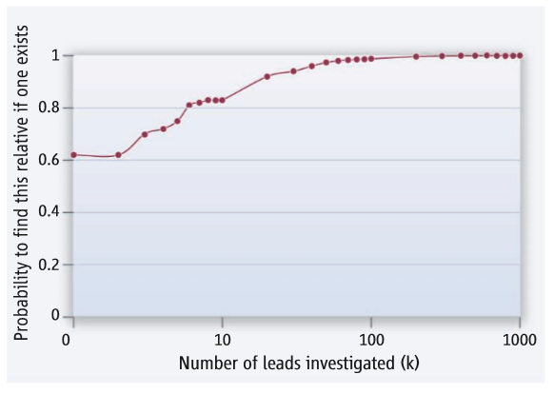
Bieber et al.
The parent is among the top
100 leads <99% of the time
About 62% of the time,
the top lead is a parent

Slide 10
Conclusions
Cal-DOJ study found that 89-97% of the authentic fathers and 59-74% of the authentic full-siblings detected through their approach.
This provides confidence that their process will more likely than not detect a true relative should a paternally-related full-sibling, parent, or child be present in the database.
Similar results to other studies.
Myers et al. 2011, FSI-Genetics

Slide 11
Limits of Familial Searching
Not performed at a national level (only states)
False positives (allele sharing by chance)
Y-STR testing – can reduce the number of false positives
Females in the database – No Y-STR testing!!

Slide 12
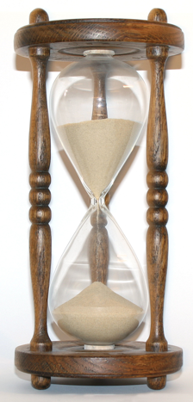
What if Familial Searching Fails?
Continue to wait for the POI or a close family member to be enrolled in the CODIS database…

Slide 13
Familial Searching (FGG)

Slide 14
STRs vs. SNPs
AGCT
7
8
C
9
T
10
11
12
13
28 possible genotype combinations
3 possible genotype combinations
CC
CT
TT
7,8 9,13 10,11 12,13
9,9 11,11 8,9 10,13
etc…

Slide 15
SNPs for Forensic Identification
G
A
A
ACTTACCGTTCCTGAAGG
A
T
T
T
ATTTACCGCTCCTGAGGG
A
A
G
ATTTACCGTTCCTGAAGG
A
C
T
C
G
ACTTACCGTTCCTGAGGG
T
G
G
~90 ‘random’ SNPs = Full STR Profile
SNPs in close proximity = Genealogy

Slide 16
Large “Blocks” of shared SNPs
108 cM fragment
ACTTACCGTTCCTGAAGG
Me
ATTTACCGCTCCTGAGGG
ATTTACCGTTCCTGAAGG
Likely 2nd or 3rd Cousins
ACTTACCGTTCCTGAGGG
1 centiMorgan (cM) = 1 million bases of DNA
People in FamilyTree DNA
or GED match Database

Slide 17

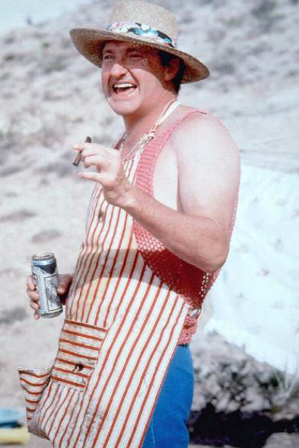
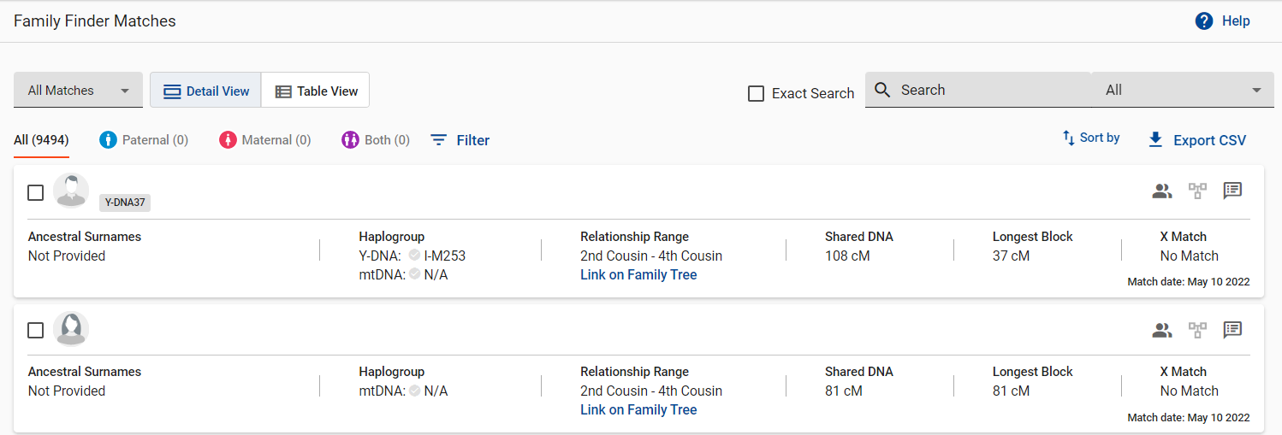

My Cousins

Slide 18
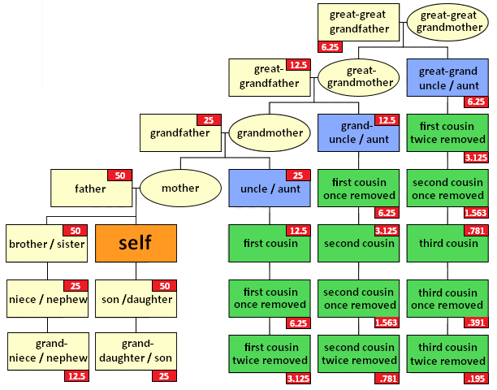
Relationships (with %DNA Shared)
ISOGG wiki statistics:
Parent/child: 3539-3748 cMs
1st cousins: 548-1034 cMs
1st cousins 1R: 248-638 cMs
2nd cousins: 101-378 cMs
2nd cousins 2R: 43-191 cMs
3rd cousins: 43-ca 150 cMs
3rd cousins 1R: 11.5-99 cMs
More distant cousins: 5-ca 50 cMs

Slide 19
Company | 23andMe | Family Tree DNA’s Family Finder test | Ancestry.com's AncestryDNA test
Price (as of January 2021) | $99 for Ancestry and Traits | $79 for the lifetime of the platform | $69 in the U.S.
SNP chip used for testing | Customized Illumina GSA chip | Customized Illumina GSA chip | Customized Illumina chip
Number of autosomal SNPs tested | 630,132 | 612,272 | 637,639
Number of people in the database (as of 13 August 2023) | 14,000,000 | 1,574,253 | 23,000,000
Over 46 million people have submitted DNA for testing!
23 and Me
Family Tree DNA
Ancestry.com
https://isogg.org/wiki/Autosomal_DNA_testing_comparison_chart

Slide 20



GEDmatch
an open-source personal genomics database and genealogy website
Allows people to search for close relatives across the platforms
23 and Me
Family Tree DNA
Ancestry.com
As of October 2023, the GEDmatch database has over 1.4 million genetic profiles
Note: FamilyTree DNA allows users to opt-in for LE searches

Slide 21
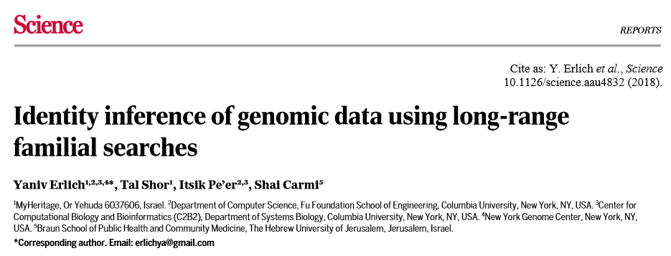
How Effective is this process?
With ~ I million people in GEDmatch, about 60% of the US European population can be identified (using 3rd cousins).

Slide 22
Applying FIGG to Investigations
Steps
Single Source Profiles – review of cases with the lead agencies
Review of DNA Evidence by Designated Lab Official
Y-STR testing – (is there enough for both tests)
CODIS Familial Search – Is victim and DA’s Office willing to prosecute

Slide 23
Codis familial searches
Requests for familial searching:
Directed to Texas State CODIS Administrator
Submitted by CODIS Forensic Laboratory
Must include memos from law enforcement and district attorney
Lab Process:
13 - 20 loci for STR and a Y-STR profile (preferably full profiles but can proceed with less)
60 manhours
$13K to $14K per search (No cost to Agencies)
Results:
Receive candidate list – 1000 to 2000 offenders. Texas CODIS Database has over 1 million offender profiles
Evaluate top 150 to 250 offenders
If no match, there are still others lower on the list
Can complete one familial search per year (per case)

Slide 24
Applying FIGG to Investigations
Steps
SNP/WGS testing - Single Nucleotide Polymorphisms/Whole Genome Sequencing
Need at least 1ng (nanogram) of suspect dna
A nanogram is a billionth of a gram – the size of a paperclip in a billion pieces

Slide 25
Applying FIGG to Investigations
Steps
Need to know the quantity of the extract
Need to know the quality of the extract (the ratio of male dna to female dna)
65% male to 35% female or better depending on the type of testing
Is there degradation of the sample?

Slide 26
Applying FIGG to Investigations
Steps
Sample is sent to a lab for testing
Sample is uploaded into genealogy databases (family tree dna and gedmatch)
Screening report
Provides an idea of relationship to unknown sample
Centimorgans

Slide 27
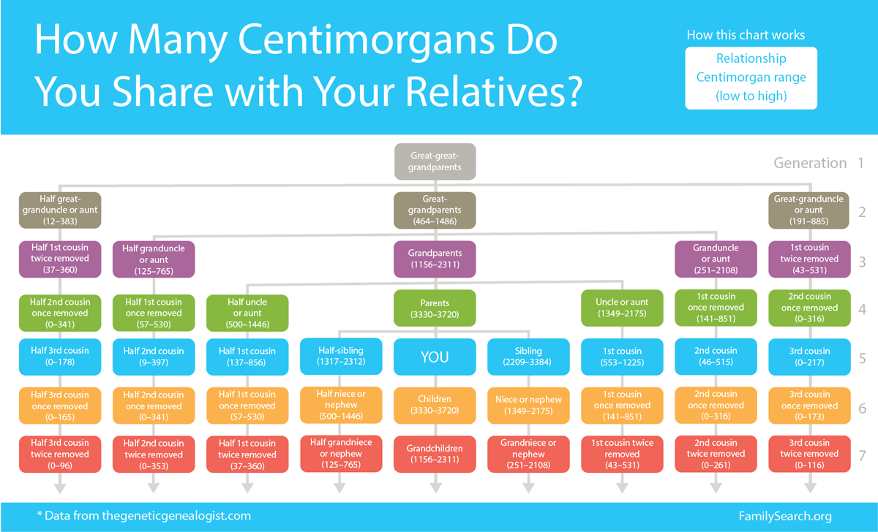
Applying FIGG to Investigations

Slide 28
Applying FIGG to Investigations
Steps
Genealogy Research – genealogist will research family members through public databases (obituaries, newspapers, social media, etc.)
Trying to triangulate family trees
Target test – voluntary testing of possible family members to help build the family trees (consent)

Slide 29
Applying FIGG to Investigations
Steps
Possible suspect –
covert sample – discarded trash or abandoned items which would contain his dna
Send item for STR testing
if matches then probable cause for search warrant and/or arrest warrant depending on DA’s request

Slide 30
Applying FIGG to Investigations
other options
Y-STR Surname Search
Phenotyping – individual characteristics including probability of hair, eye, and skin color – last resort

Slide 31
US DOJ, Bureau of Justice Assistance
National sexual assault kit initiative (SAKI)
Purpose area 4 – Investigation and prosecution of cold case sexual assaults and homicides

Slide 32

This project was supported by Grant Nos. 2019-AK-BX-0019, which were awarded by the Bureau of Justice Assistance. The Bureau of Justice Assistance is a component of the U.S. Department of Justice's Office of Justice Programs, which also includes the Bureau of Justice Statistics, the National Institute of Justice, the Office of Juvenile Justice and Delinquency Prevention, the Office for Victims of Crime, and the SMART Office. Points of view or opinions in this document are those of the author and do not necessarily represent the official position or policies of the U.S. Department of Justice.

Slide 33
Pa4 - The problem?
Nonexistent outsourcing for forensic genetic genealogy for DNA samples from unknown offenders linked to unsolved Sexual Assaults and Murders.
Over 30,000 unknown offender profiles in CODIS with no offense specific data available. We do not know how many unsolved murders vs. Sexual Assault cases are in CODIS.
The DPS Lab and the TRD originally identified 27 serial offenders in CODIS that are associated with 118 Unsolved Sexual Assaults and Murders.
Purpose area 4

Slide 34
Pa4 - The SOLUTION:
Purpose area 4 grant provides support for the investigation/prosecution of individuals whose DNA is in CODIS as an unknown profile related to cold case sexual assaults and homicides..
Funding may be used for outsourcing of DNA testing and Genealogy testing and research.
Grant will fund outsourcing of existing DNA samples for Y-STR testing for CODIS Familial Searches and also Genealogy testing and research.
Purpose area 4

Slide 35
MORE SOULTIONS:
Grant will fund CODIS Familial Searches.
Fund investigators to pursue leads of possible relatives of the offender.
Fund Genealogy Testing and Research
Funds the outsourcing of DNA verification tests of suspected offenders for rapid turn around (<72 hrs)

Slide 36
Purpose Area 4
DPS Labs – 10
Non dps Labs – 7
Codis Lab - 1

Slide 37
Purpose Area 4
49 forensic unknown serial offenders responsible for 178 sexually related offenses.
422 Homicides with single source forensic profile in CODIS from DPS Labs
184 Female Homicides with single source forensic profiles in CODIS.
38 Unsolved Female homicides with a sexual nexus
5,512 sexual Assault cases with single source forensic profiles in CODIS DPS labs

Slide 38
Purpose area 4
Total saki Cases reviewed/Being Worked:
Homicides – 80
Sexual Assaults – 200
Unidentified – 5

Slide 39
Purpose Area 4
Codis Lab - 1
46 familial searches completed to date
9 familial searches pending completion
9 leads produced
6 suspects Identified and confirmed thru DNA
3 pending suspect identification

Slide 40
Purpose Area 4
genealogy
37 samples sent for testing – 3 Samples did not proceed
31 cases proceeded to Genealogy Research
11 cases solved (1 by agency without Genealogy)
1 Unidentified female victim identified
16 cases being target tested for further leads or further genealogy researched
2 cases being Monitored
1 case pending genealogy testing

Slide 41
Purpose area 4
Total SAKI Cases SolveD to date:
Homicides – 15
Sexual Assaults – 94
Unidentified Victims Identified- 2

Slide 42
Purpose area 4
Suspects Identified from solved - 50
Arrests/indictments – 30
Outstanding Warrants – 1
Found deceased – 8
Pending Arrest/indictment – 6
Dismissed by Prosecution – 4
No billed - 1

Slide 43
Purpose area 4
Suspects Identified by:
Agency reviewed case/confirmed with DNA - 21
Codis hits – 13
Familial search – 6
Genealogy - 10

Slide 44
DNA Technology on the Horizon:
Final Thoughts on
Forensic Investigative Genetic Genealogy (FIGG)

Slide 45
Forensic Investigative Genetic Genealogy
FIGG
IGG
FGG

Slide 46
FIGG/IGG/FGG: What It Is Not
Not CODIS Familial Searching
different from forensic genealogy
searching state CODIS databases to look for close male relatives of an unknown offender (brothers, fathers, uncles, sons); using Y-STR profiles (male profiles)
only allowed in 13 states (including Texas)

Slide 47
STR vs SNP
STR uploaded to CODIS
SNP uploaded to consumer genealogy database
STR=Short Tandem Repeats
Crime scene STR profile is compared to the profiles stored in CODIS to find potential perpetrators
40% chance of producing a match (lead)
Uploaded by LE according to statute
SNP=Single Nucleotide Polymorphisms
Different type of testing (but can take from same extract used from crime scene if enough sample left after STR testing) and profile is uploaded and compared to users in public databases
80%-90% chance of producing a lead by matching to a 2nd or 3rd cousin
Voluntary upload

Slide 48
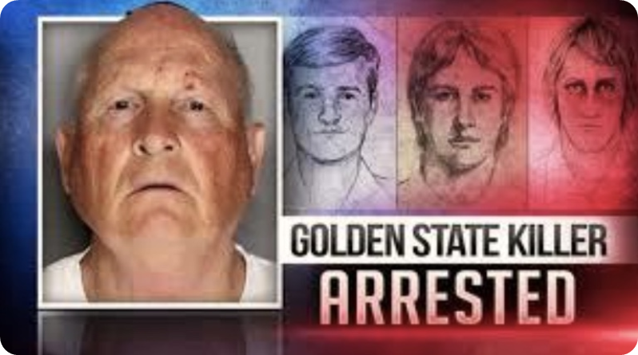
Genealogy In the News

Slide 49
The Power of the Tool
-credit to Steve Kramer, Indago Solutions, former FBI and Anne Marie Schubert, former Sacramento District Attorney
After Using FIGG
Before Using FIGG
Took 43 years to solve the Golden State Killer cases
650 investigators over the years and 15 LE agencies
8000 persons of interest/300 people swabbed for DNA
200k man/woman hours=$10 million dollars
Took 63 days to identify Joseph James DeAngelo as the Golden State Killer
6 people to work the family tree
$217 (cost of SNP testing back then)

Slide 50
Facts about FIGG
Law enforcement does not have access to medical information when they use genealogy databases. They have information on how families are related within centimorgans “cM” so they can begin building and researching family trees and histories.
FIGG only provides law enforcement with a lead. Detectives must still conduct further investigation by obtaining subsequent samples and confirming the lead by using a one-to-one STR test to make sure they have the right individual.

Slide 51
Facts about FIGG
Ancestry.com, 23 and Me, and others do not allow law enforcement to use their databases. Only Family Tree DNA and GEDmatch allow law enforcement to use their databases, and both require their users to “opt-in or out" before allowing law enforcement to find genetic relatives
More than 75% of all new GEDmatch users “opt in” for law enforcement to use its databases

Slide 52
Considerations About Using FIGG
Art. 38.35 of the Texas Code of Criminal Procedure
    Be careful if using labs to do SNP testing that are not accredited by the TFSC https://fsc.txcourts.gov/AccreditedLabPublic
Discovery
    Could be asked to turn over materials used during FIGG research. Some states have successfully fought these requests under Brady, but may not have as good of an argument under Michael Morton Act
DOJ Guidelines
    Interim policy on FIGG with specific requirements before FIGG can be used including having an STR profile uploaded into CODIS and getting prosecutorial approval https://www.justice.gov/olp/page/file/1204386/download

Slide 53
Considerations About Using FIGG
Privacy Challenges
    Claim that use of genealogy database violates 4th Amendment because right to privacy in shared DNA of relatives. Courts so far have found this an unpersuasive argument based upon a lack of standing and no property interest in a 3rd party’s genetic material voluntarily uploaded
    Claims invoking Carpenter (comparing genealogy to cell phone location data w/privacy interest)
    Abandoned property claims (trash runs/discarded items)
Future Legislation
    Efforts to regulate vary widely from state to state mainly because of a lack of understanding of databases and information available to law enforcement
    Must use responsibly or will lose this valuable tool
    Can implicate but can also exonerate

Slide 54
Resources
  *Investigative Tools for Solving Cold Cases*
  Dec. 5-6
  Horseshoe Bay Resort
  *OAG and Texas Rangers BJA Grant Awards*
  OAG Cold Case and Missing Persons Unit
  coldcaseunit@oag.texas.gov
  Texas Rangers SAKI Grant Award
  Trampas.Gooding@dps.texas.gov
  *Season of Justice*
  https://seasonofjustice.org/
  https://verogen.com/law-enforcement-forensic-investigative-genetic-genealogy/#glossary

