Slide 1
You Can Do It: Achieving a Basic Understanding of DNA Statistics
Understanding Forensic DNA Analysis: A Program for Lawyers and Judges
Michael Coble (UNTHSC/CHI)
Nic Hughes (Nicolas Hughes Law Firm)
Bill Wirskye (Collin County DA’s Office)
Texas State Capitol Auditorium
November 2, 2023

Slide 2
Requirements for creating a statistic (DNA)
Population allele
frequencies
Population Genetic
Formula
Data from the evidence
(Alleles)
Match Rarity
or
Match Probability

Slide 3
Inclusions (Matches) Require Statistics
It would not be scientifically justifiable to speak of a match as proof of identity in the absence of underlying data that permit some reasonable estimate of how rare the matching characteristics actually are.
-- NRC II (1996), p. 192

Slide 4
Statistics for DNA mixtures
Combined Probability of Inclusion (or Exclusion)
Random Match Probability (modified RMP)
Likelihood Ratios

Slide 5
Combined Probability of Inclusion (CPI)
Calculation of the probability that a random (unrelated) person would be excluded/included as a contributor to the observed DNA mixture
Requires a stochastic threshold!
Advantage – easy to calculate, relatively easy to understand
Disadvantage – there is a risk of providing strong evidence for a non-contributor.

Slide 6
Stochastic Threshold (ST)
The ST helps the analyst to assess the risk of having missing data due to allele drop out.
Complainant = 8, 10
POI = 9, 11
Drop out of a sister allele for the 11 is possible!

Slide 7
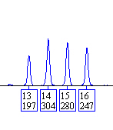
Combined Probability of Inclusion
D8
PI = (p + q + r + s)²
PI = (f₁₃ + f₁₄ + f₁₅ + f₁₆)²
PI = (0.305 + 0.166 + 0.114 + 0.031)²
PI = (0.616)²
PI = 0.379
ST = 150 RFU
f₁₃ = 0.305
f₁₄ = 0.166
f₁₅ = 0.114
f₁₆ = 0.031
PI ~ 1 in 2.6 individuals
(PE = 1 – CPI = 0.621)

Slide 8
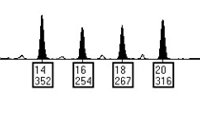
Combined Probability of Inclusion
D8
D18
PI = 0.379
PI = 0.338
CPI = (0.379) x (0.338) = 0.128
(CPE = 1 – CPI = 0.872)

Slide 9
Note: this CPI statistic (1 in 835) is coming from only 4 loci: D8, D21, D7, and CSF1PO
(Amelogenin is not used for statistical purposes)

Slide 10
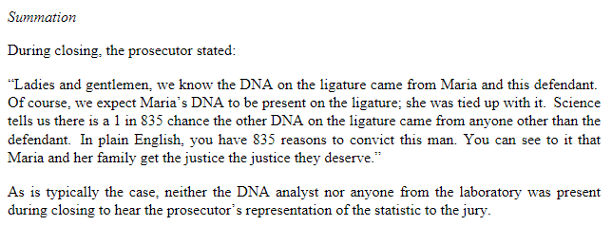

Slide 11
Curran and Buckleton (2010)

Slide 12
Curran and Buckleton (2010)
?
Could he fit
in the mixture?
(discarded some
of the data)
12,13
12,14
12,12
12,13,14
1,000 Random Profiles
Mixed together
10,000 Random Profiles
Not part of the mixture

Slide 13
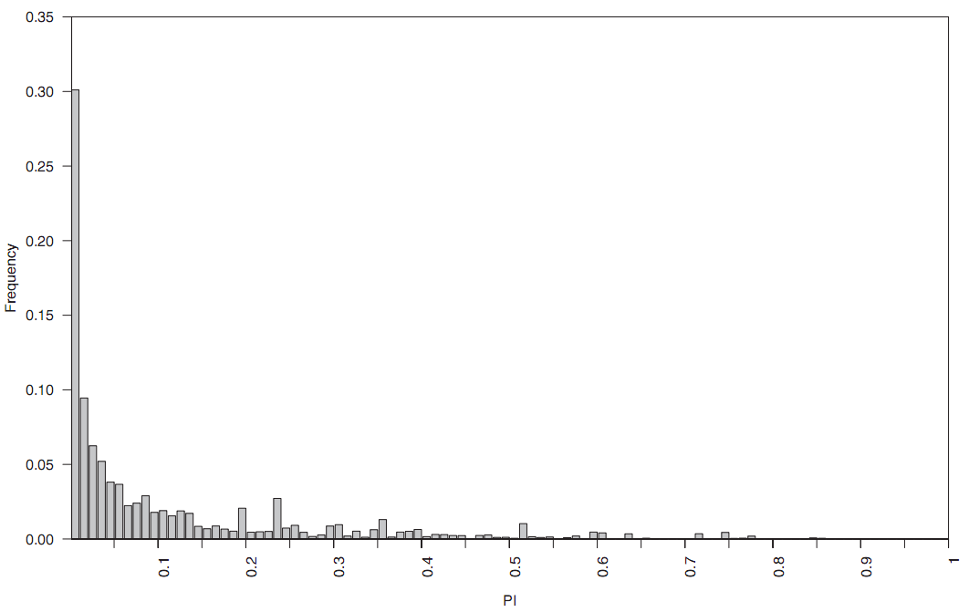
Curran and Buckleton (2010)
“the risk of producing apparently strong evidence against
an innocent suspect by this approach was not negligible.”
30% of the cases had a CPI < 0.01
48% of the cases had a CPI < 0.05

Slide 14
Random Match Probability (RMP)
Separate major and minor components into individual profiles and compute the random match probability estimate as if a component was from a single source (sometimes called a modified RMP)
Requires a stochastic threshold!
Advantage – based on sound population genetic theory, easy to understand, better use of the data
Disadvantage – can be challenging to calculate for higher order mixtures (3+).

Slide 15
Random Match Probability
D8
Complainant = 13, 15
POI = 14, 16
mRMP = 2pq
mRMP = 2 * f₁₄ * f₁₆
mRMP = 2 * 0.166 * 0.031
mRMP = 0.01
ST = 150 RFU
f₁₃ = 0.305
f₁₄ = 0.166
f₁₅ = 0.114
f₁₆ = 0.031
mRMP ~ 1 in 100 individuals

Slide 16
Random Match Probability
D8
D18
RMP = 0.01
RMP= 0.05
RMP = (0.01) x (0.05) = 0.0005
~ 1 in 2000

Slide 17
04-01: vaginal swabs from Maria Murphy
The DNA profile from the epithelial cell fraction of this item is consistent with the DNA profile of Maria Murphy.
The DNA profile from the sperm cell fraction of this item is consistent with a mixture from Maria Murphy
and Sebastian Bruno. Sebastian Bruno cannot be excluded as the contributor of the major component
in the profile.
The probability of selecting an unrelated person at random who could be the source of the
major component in this profile is approximately 1 in 4,000,000,000,000,000 (4 quadrillion) for Caucasians,
1 in 3,800,000,000,000,000 (3.8 quadrillion) for African Americans, and 1 in 3,900,000,000,000,000 (3.9 quadrillion)
for Hispanics.
To a reasonable degree of scientific certainty, Sebastian Bruno is the source of the foreign DNA in the profile
(excluding identical twins).

Slide 18
Likelihood Ratio (LR)
The LR is NOT a probability!! It is an evaluation of the DNA profile under two (or more) conditional hypotheses to explain the evidence.
Requires a stochastic threshold (unless you use STRmix)!
Advantage – logical approach, better use of the data
Disadvantage – can be difficult to explain to jurors, judges, prosecuting attorneys, defense attorneys, investigators, and very young children.

Slide 19
The Likelihood Ratio

Slide 20
The Likelihood Ratio
Conditional
Probability

Slide 21
Conditional Probability
What is the probability of B, given that A has happened?
Probability of event B
A has occurred
Given that
(or “if”)
Slide from Brian Harmon and Steven Myers

Slide 22
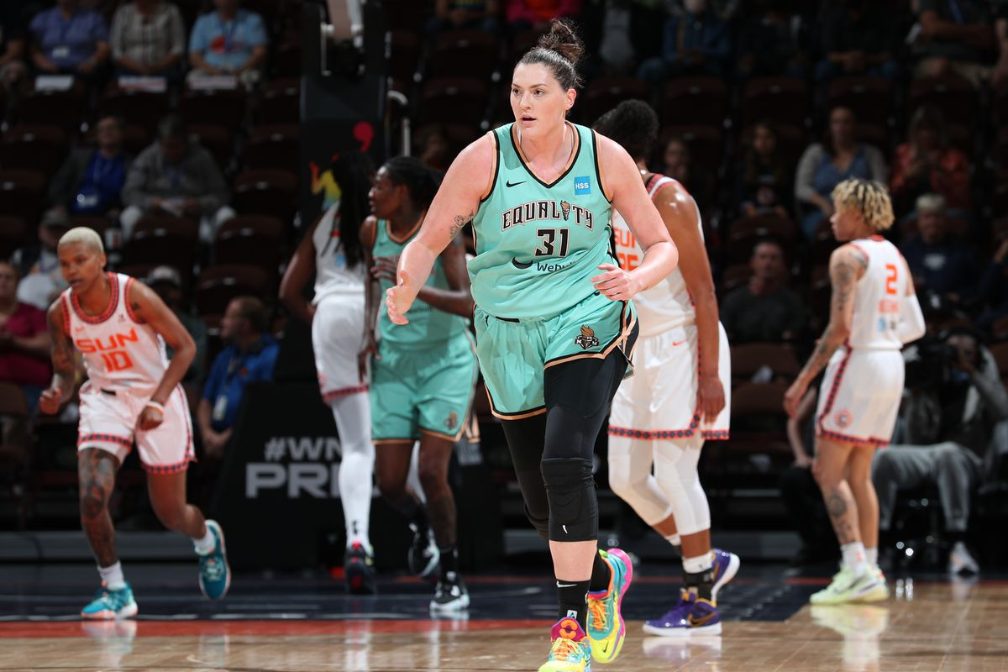
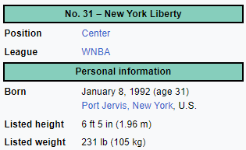
How Tall is Stefanie?
Stephanie Dolson

Slide 23
An “easy” way to explain a Likelihood Ratios to non-scientists

Slide 24
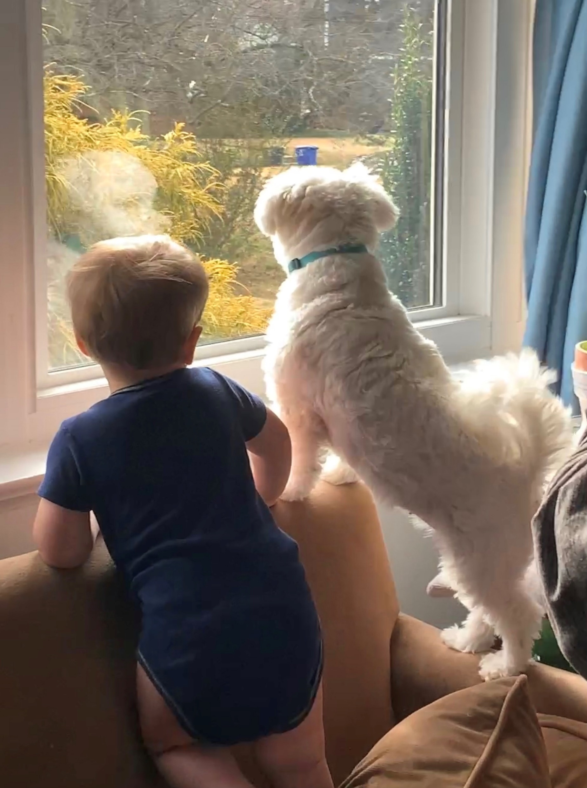
Come on hooman… bark with me!
Why is my dog barking?!?!?
She sees a squirrel in the front yard
(H1)
She sees a stranger in front of
our house
(H2)

Slide 25
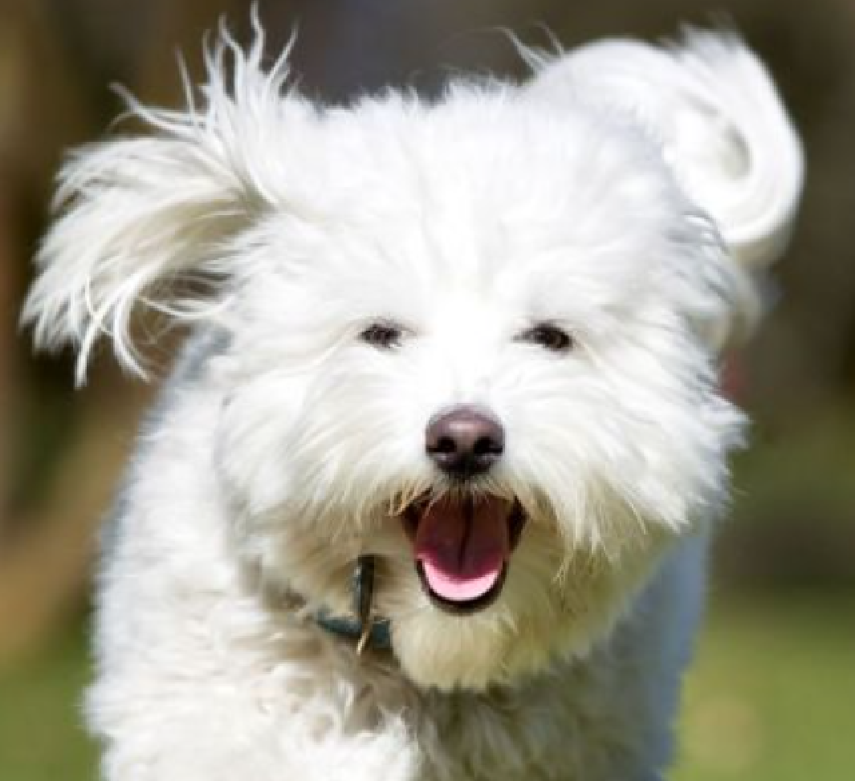
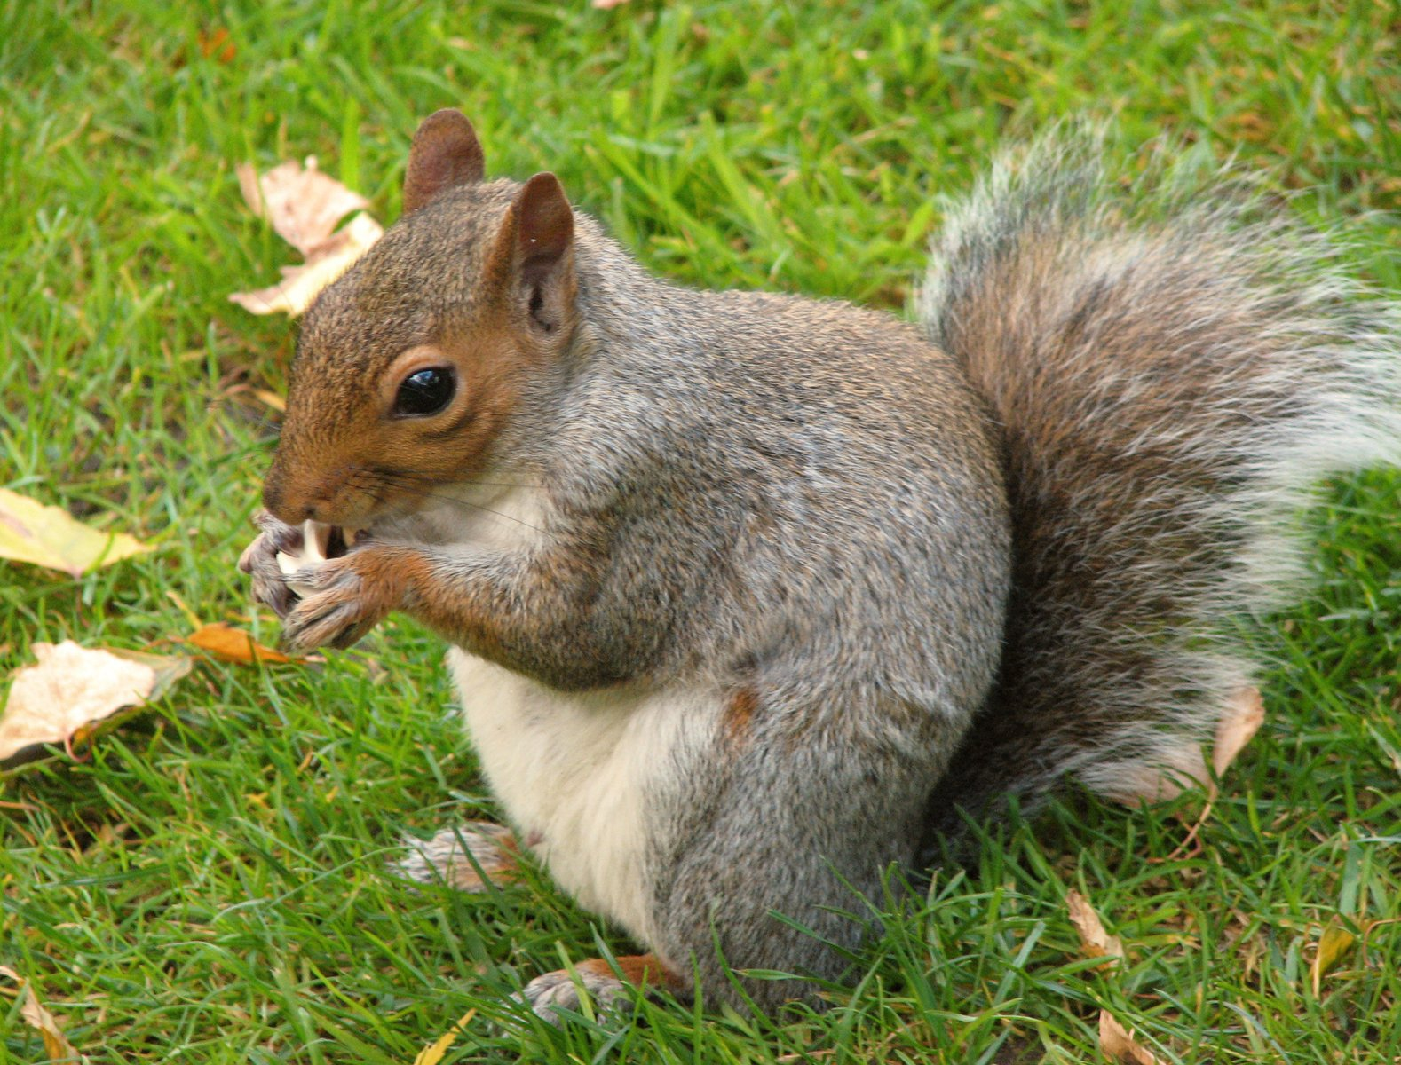
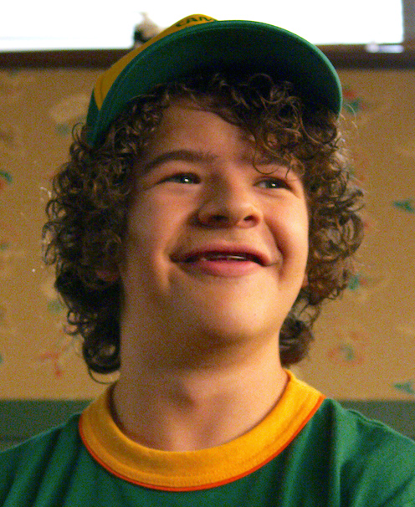
Let’s evaluate some EVIDENCE
Counts (200 total)
Squirrel 188
Stranger 12
H1
Pr(E | H)
188/200 = 0.94
Ratio = 15.66
(15)
12/200 = 0.06
H2
The Evidence (my dog is barking) is 15 times more likely to be observed if a squirrel
is in my front yard rather than if a stranger is walking in front of my house.

Slide 26
The Likelihood Ratio Must Be Stated Carefully
The evidence is 1 million times more likely to be observed if the stain originated from the complainant and the POI (Mr. Smith) rather than if the stain originated from the complainant and an unknown, unrelated individual selected at random in the population.
It is not appropriate to say: “It’s 1 million times more likely that Mr. Smith left the stain than some other random person in the population.”
We start by talking about the Evidence and then use the word ‘if’ when using a likelihood ratio to make the hypotheses clear in the statement to avoid this trap.

Slide 27
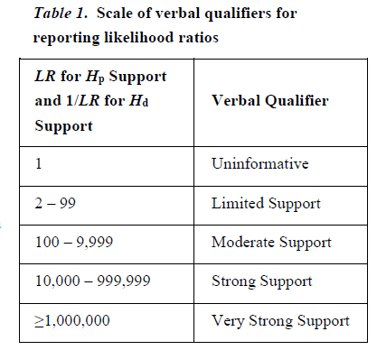
Verbal Scale

Slide 28
DPS Verbal Scale
Uninformative
0.5 – 2.0
0.1
1
Exclusionary
Inclusionary

Slide 29
Probabilistic Genotyping
Over the past decade, the forensic DNA community has moved (and continues to move) to probabilistic methods of interpretation.
For many laboratories, this has been a paradigm shift.
Manual Interpretation
with Thresholds
CPI
PG Software Tools
LRs

Slide 30
Probabilistic Genotyping
“The use of biological modelling, statistical theory, computer algorithms, and probability distributions to calculate likelihood ratios (LRs) and/or infer genotypes for the DNA typing results of forensic samples.”
Some of the combinations may be “weighted” as more probable than other combinations.
All of this is dependent on the models used for interpretation.
SWGDAM Guidelines for the Validation
of Probabilistic Genotyping Systems

Slide 31
The Goal of Mixture Interpretation
Determining the possible genotype combinations to a DNA sample
Complainant = 11, 13
11
13
15
11
13
15
Manual Interpretation
(with Thresholds)
Probabilistic Interpretation
(with Software)
11, 15
13, 15
15, 15
33.33%
33.33%
33.33%
11, 15
13, 15
15, 15
20.15%
30.51%
49.34%
All genotype combinations
are equally weighted
Some genotype combinations can be
weighted more than others

Slide 32
Why did the forensic DNA community move to Probabilistic Genotyping?
03-01: cuttings of three stains having the appearance of semen from light grey hooded sweatshirt
The DNA profile obtained from this item is consistent with a mixture of at least three contributors.
Due to the low level of data present above our thresholds, no comparisons will be made.
4-05-AA: right hand fingernail swabs from Maria Murphy
The DNA profile obtained from this item is consistent with a mixture of at least two individuals.
Maria Murphy cannot be excluded as a contributor to the profile.
Due to the quantity and/or quality of DNA obtained, no conclusions can be made regarding the
DNA profile obtained from the additional contributor(s).

Slide 33
03-01: cuttings of three stains having the appearance of semen from light grey hooded sweatshirt
The DNA profile obtained from this item is consistent with a mixture of at least three contributors.
Due to the low level of data present above our thresholds, no comparisons will be made.
03-01: cuttings of three stains having the appearance of semen
The previously developed DNA profile from this item was re-assessed utilizing probabilistic genotyping.
The DNA profile from this item is interpreted as a mixture of three individuals.
The probability of obtaining this profile if the DNA came from Maria Murphy and two unrelated, unknown individuals
is 500,000 times greater than the probability of obtaining this profile if the DNA came from three unrelated, unknown
individuals. This likelihood ratio indicates strong support for the proposition that Maria Murphy is a possible contributor
to the profile (refer to Appendix).
The probability of obtaining this profile if the DNA came from Sebastian Bruno and two unrelated, unknown individuals
is 5,000,000 times greater than the probability of obtaining this profile if the DNA came from three unrelated, unknown
individuals. This likelihood ratio indicates very strong support for the proposition that Sebastian Bruno is a possible
contributor to the profile (refer to Appendix).
The probability of obtaining this profile if the DNA came from Maria Murphy, Sebastian Bruno, and one unrelated,
unknown individual is 5,000,000,000,000 (5.0 trillion) times greater than the probability of obtaining this profile if
the DNA came from three unrelated, unknown individuals. This likelihood ratio indicates very strong support for
the proposition that Maria Murphy and Sebastian Bruno are possible contributors to the profile at the same time
(refer to Appendix).

Slide 34
4-05-AA: right hand fingernail swabs from Maria Murphy
The DNA profile obtained from this item is consistent with a mixture of at least two individuals.
Maria Murphy cannot be excluded as a contributor to the profile.
Due to the quantity and/or quality of DNA obtained, no conclusions can be made regarding the DNA profile obtained from the additional contributor(s).
04-05-AA: right hand fingernail swabs
The previously developed DNA profile from this item was re-assessed utilizing probabilistic genotyping.
The DNA profile from this item is interpreted as a mixture of two individuals with Maria Murphy as an assumed contributor.
Based on the likelihood ratio result, Sebastian Bruno is excluded as a contributor to the profile (refer to Appendix).

