Slide 1

Motions for Summary Judgment
Compliance and Reporting Requirements
Texas Office of Court Administration
Data & Research Division
April 2026

Slide 2

In This Webinar:
Reporting Background & Stakeholders
Reporting Requirements
Requirements Detail
Reporting Examples
Additional Information

Slide 3

Background & Stakeholders

Slide 4
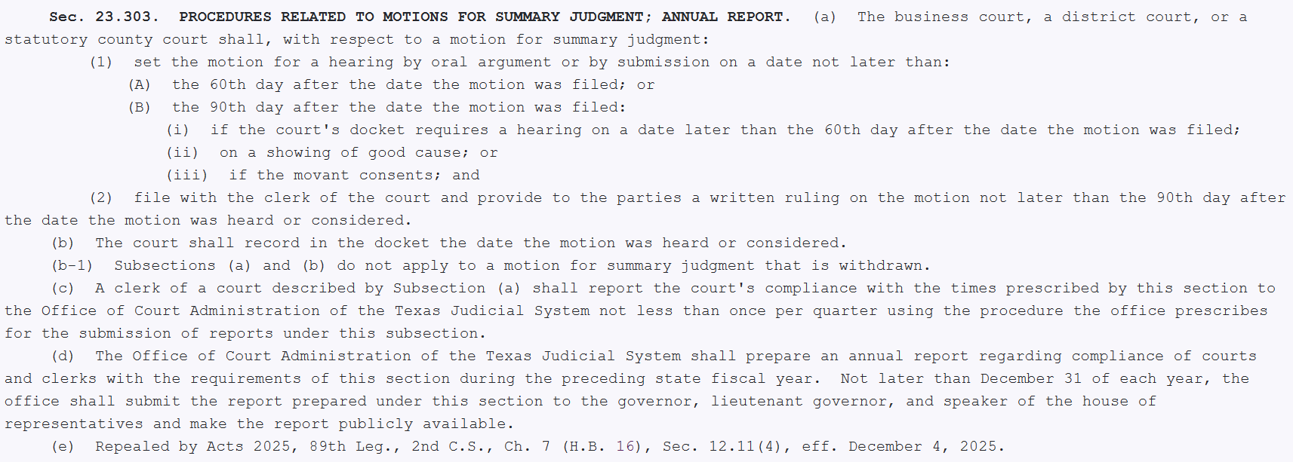
Statute
Government Code, Section 23.303 (added by SB 293, 89th R.S.; amended by HB 16, 2nd Called Session, 2025)
Texas Rules of Civil Procedure, Rule 166a (Texas Supreme Court adopted 2/27/2026, Misc. Docket 26-9012)

Slide 5
Stakeholders
Business Court, District Courts, and Statutory County Courts
No Constitutional County Courts need to report.
Stakeholders include judges, court coordinators, clerks, and case management system vendors.
Processes will vary by jurisdiction.

Slide 6

Requirements

Slide 7
Reporting Requirements
Clerks must submit a quarterly report of each court’s compliance.
OCA must prepare an annual report, no later than December 31st.
The annual report must be made publicly available.

Slide 8
Reporting Timeframe
Date Range | Quarter | Report Due Date
Sep 1 - Nov 30 | 1 | Dec 20
Dec 1 - Feb 28/29 | 2 | Mar 20
Mar 1 - May 31 | 3 | Jun 20
Jun 1 - Aug 31 | 4 | Sep 20
The reporting requirements are effective March 1, 2026. All MSJs filed on or after March 1, 2026, should be reported.
The report must be submitted to OCA on the 20th of the month following the end of a quarter.
The first report, covering FY 2026 Q3 (March – May 2026), will be due September 20th.

Slide 9

Breaking Down the Reporting Requirements

Slide 10
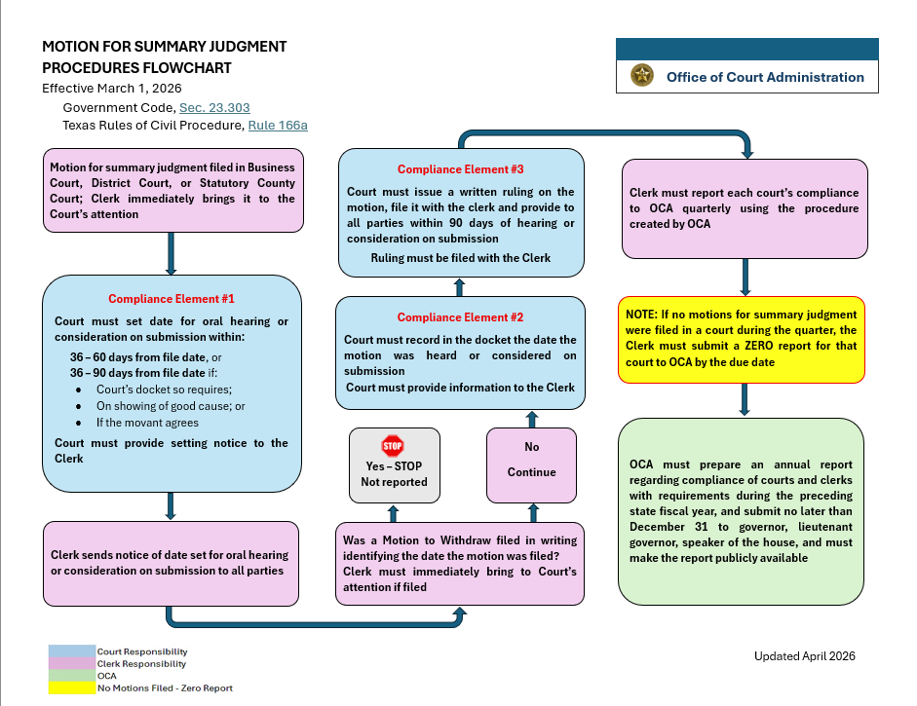
https://www.txcourts.gov/reporting-to-oca/district-county-court-level-reporting/motion-for-summary-judgment/

Slide 11
Compliance Elements
#1 Court setting date for oral hearing or consideration on submission
Court must set no later than the 60th day from the date the motion was filed or the 90th day from date of filing:
If the court’s docket requires a later date;
On a showing of good cause; or
If the movant consents.

Slide 12
Compliance Elements
#2 Court ruling file date
The court must record in the docket the date the motion was heard or considered on submission.
The court must sign a written ruling on the motion, file it with the clerk, and provide the ruling to the parties within 90 days after the hearing or submission docket entry date.
Compliance Factors:
Case events that are instrumental in measuring compliance but are not reportable elements include:​
Motion for Summary Judgment file date – controls the setting deadline.​

Slide 13
Tracking Strategies
Motion for Summary Judgment Filed
MSJ file date is the starting point for tracking compliance with the timelines.
CMS filing or event types will need to be unique to ensure accurate report mapping.
Motion for Summary Judgment Withdrawn
If a MSJ is withdrawn, the compliance timelines and reporting requirements do not apply.
Filing / Event Type – Notice of MSJ Withdrawal

Slide 14
Tracking Strategies
Compliance Element #1 – Court Setting Date
The court will need to provide this date to the clerk, e.g., Notice of Setting, Order Setting, or hearing type data to capture the setting date.
CMS filing / event types or hearing types will need to be unique to ensure accurate report mapping.
The court will also need to provide notice of reset to the clerk when applicable.

Slide 15
Tracking Strategies
Compliance Element #2 – Court Ruling File Date
Clerk must receive the court’s written ruling no later than 90 days from the date the court entered on the docket that the motion was heard or considered.
Filing or Event Type –
Summary Judgment
Order Denying Motion for Summary Judgment
Order Dismissing Motion for Summary Judgment

Slide 16
Prescribed Timeframes
The day of the event that starts the prescribed timeframe must not be included in the compliance period.
In calculating the setting deadline, do not include the date that the MSJ was filed.
In calculating the due date for the Court’s written ruling, do not include the hearing or submission date entered on the docket.
If the last day of a prescribed timeframe falls on a Saturday, Sunday, or legal holiday, the deadline falls on the next day that is not a Saturday, Sunday, or legal holiday.

Slide 17

Examples

Slide 18
Reporting Periods
Because of the prescribed timelines, most Motions for Summary Judgment will fall within more than one quarter.
Example:
MSJ filed 5/15/2026 (FY 2026, 3rd Quarter)
Setting deadline is 8/13/2026 (5/15/2026 + 90 days) (FY2026, 4th Quarter)
Ruling deadline date is 11/11/2026 (8/13/2026 + 90 days) (FY 2027, 1st Quarter)
Q3
MSJ Filed (5/1/26)
Q4
Q1
Setting Deadline (9/10/26)
Q2
Ruling Deadline (1/26/27)

Slide 19
MSJ Filed
Setting complete within timeframe
Ruling/Notice complete within timeframe
MSJ Filed
Setting complete within timeframe
Ruling/Notice deadline missed
N/A
MSJ Filed
Setting deadline missed
Reporting Periods
Report in the quarter in which the deadline was missed (non-compliance) OR when the ruling was filed.

Slide 20
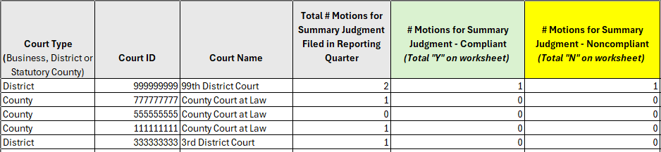
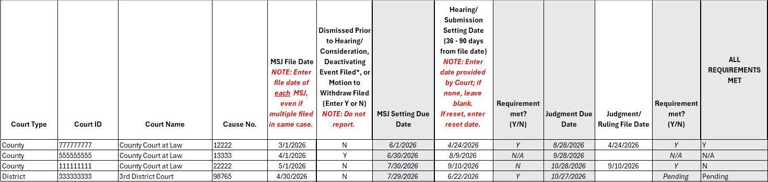
Reporting Example
Same IDs as used in Performance Measures Reports
Tracking Tool
Note: The excel workbook provided by OCA is intended to be an optional resource for tracking MSJ reporting data.
Each jurisdiction should adopt their own processes to capture the information.

Slide 21

Additional Information

Slide 22
Zero Reports
Clerks must submit a zero report for each court in which there were no motions for summary judgment filed or pending during the quarter reported.
A zero report must be submitted regardless of the types of cases heard by the court.

Slide 23
Submission Method
OCA is currently working on the submission process for these new reports and will send out notification as soon as available.
A notice to Clerks and CMS Vendors will be sent out as soon as submission guidance is complete.

Slide 24
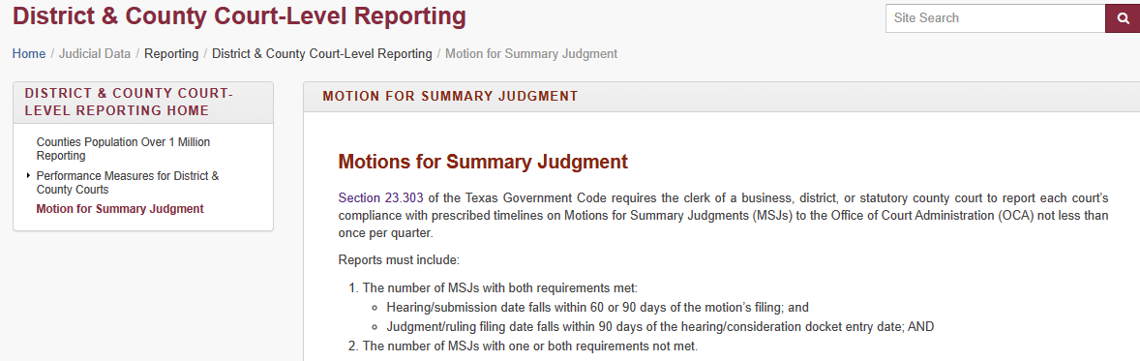
Reporting Instructions and Resources
https://www.txcourts.gov/reporting-to-oca/district-county-court-level-reporting/motion-for-summary-judgment/
Reporting Instructions and Guidance
Flowchart
Sample Timeline

Slide 25

Questions

